Slide 1
Diversity, Inclusion, and Getting More of Both in the DOC
May 3, 2020
Cherise Shockley

Slide 2
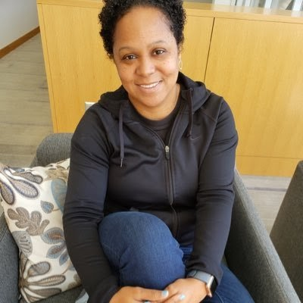
Introduction
I’m Cherise Shockley. I was diagnosed with LADA in 2004. I became insulin dependent in 2007. I stumbled across the diabetes online community (DOC) in 2008.

Slide 3
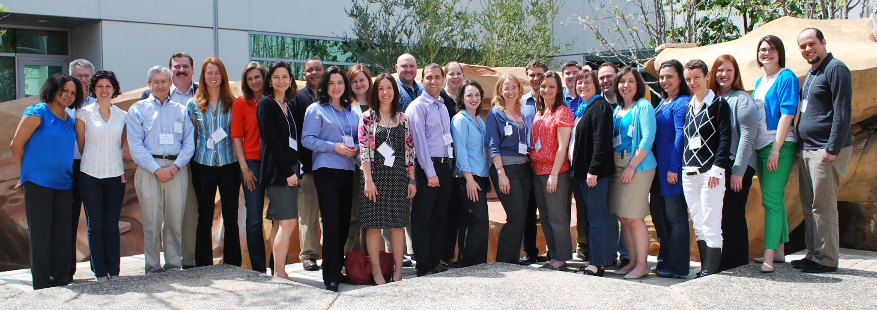
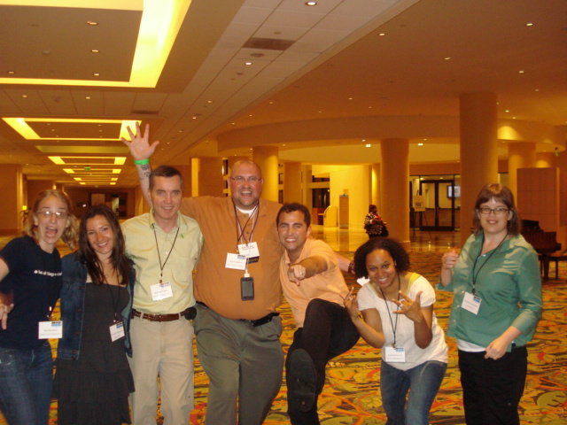
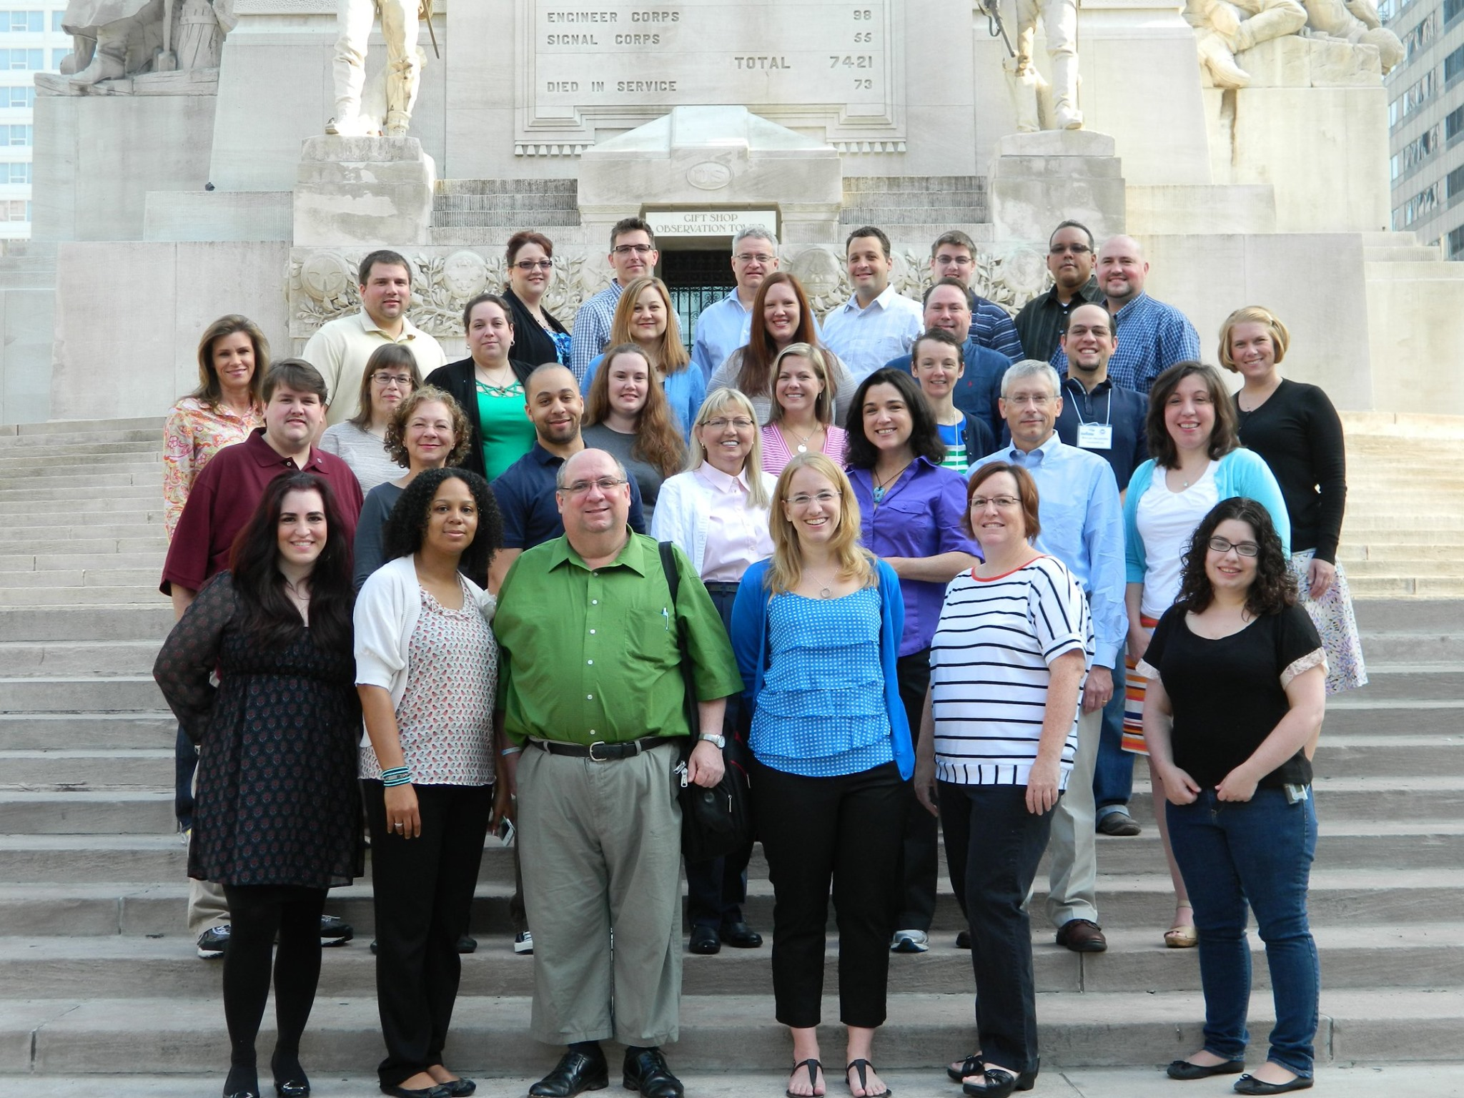
Diabetes Summits

Slide 4
—Chimamanda Ngozi Adichie
“The single story creates stereotypes and the problem with stereotypes is not that they are untrue but they are incomplete, they make one story become the only story.”-

Slide 5
Why do we need diverse stories in the DOC?

Slide 6
Replies from the Diabetes Online Community
“To inspire and empower others that we can live our lives just as ordinary people and even better than them.”-@momo_peiyan
“Unfortunately, I felt alone most of my life. I’ll have diabetes for 36 years this January and there weren’t many people that looked like me. Since being active online, thanks to you, I have a community that looks like me.”—@ladielex
“Cos every story matters. Every journey and experience is slightly different. And you never know who will be needing to hear your words.”- @hangrypancreas
“Diabetes isn’t a one size fits all disease. There are many types, many treatment options, and no two people experience the disease the same way. The more individuals who share their stories, the better chance we have at education and understanding and gaining support.”—Mike Hoskins
“We need an accurate depiction of reality. The stories told/people featured in diabetes right now is not a true reflection of that reality.”- @MTL613

Slide 7
Replies from the Diabetes Online Community
“So all people with diabetes know they’re not alone, and that everyone is represented.”- @SuzieMay08
“Because it can happen to ANYONE. It does NOT distinguish between age, sex, race, siblings, children-even adopted children. ANYONE.- Brenda
“Diverse stories help break stigma that comes with having diabetes of any type. Plus, when people who can see themselves honestly reflected in the narrative, they know they are not alone.”- @thehangrywoman
“So that PWD know it’s OK to have diabetes, diversity breaks boundaries and somehow improves self care/ management for PWDs.” - @miss_yemue92
“I’ve heard this before many times, “your diabetes may vary.” With that being said everyone has a different story and experience, I feel it’s important to tell those differences.”—Randall

Slide 8
Step outside the box

Slide 9
Connecting
“An individual has not started living until he can rise above the narrow confines of his individualistic concerns to the broader concerns of all humanity.”—Martin Luther King, Jr.

Slide 10
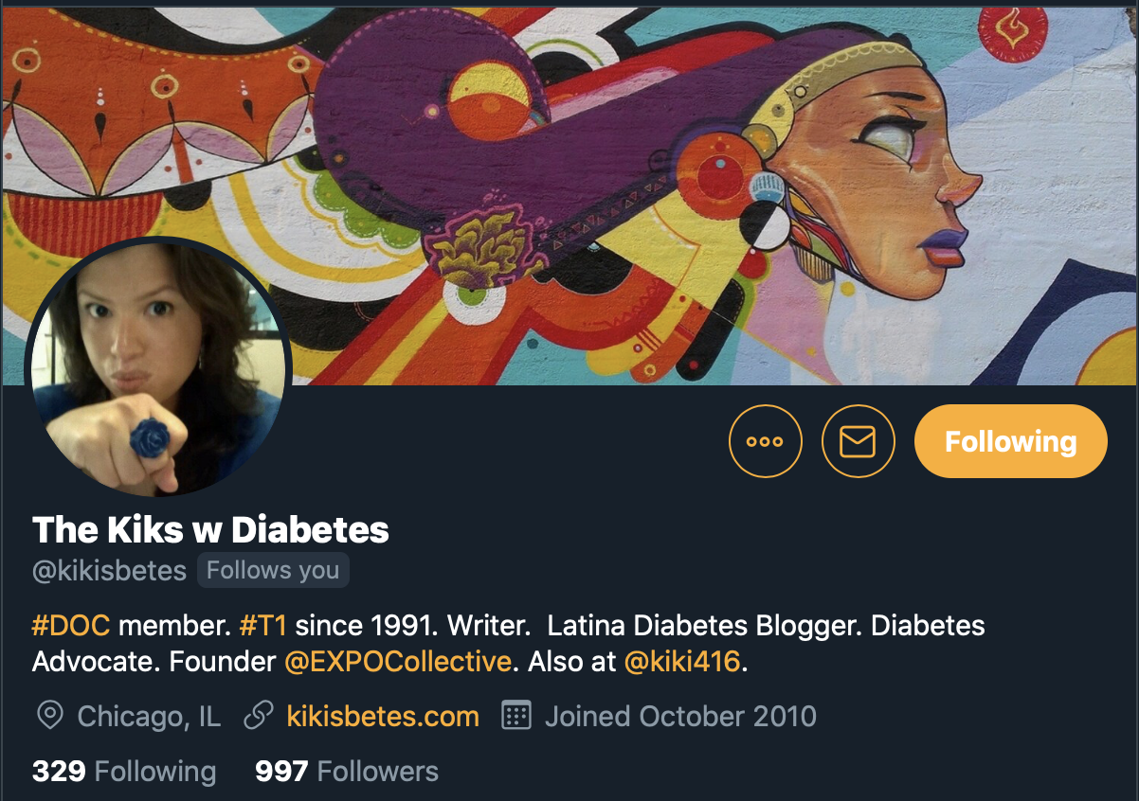
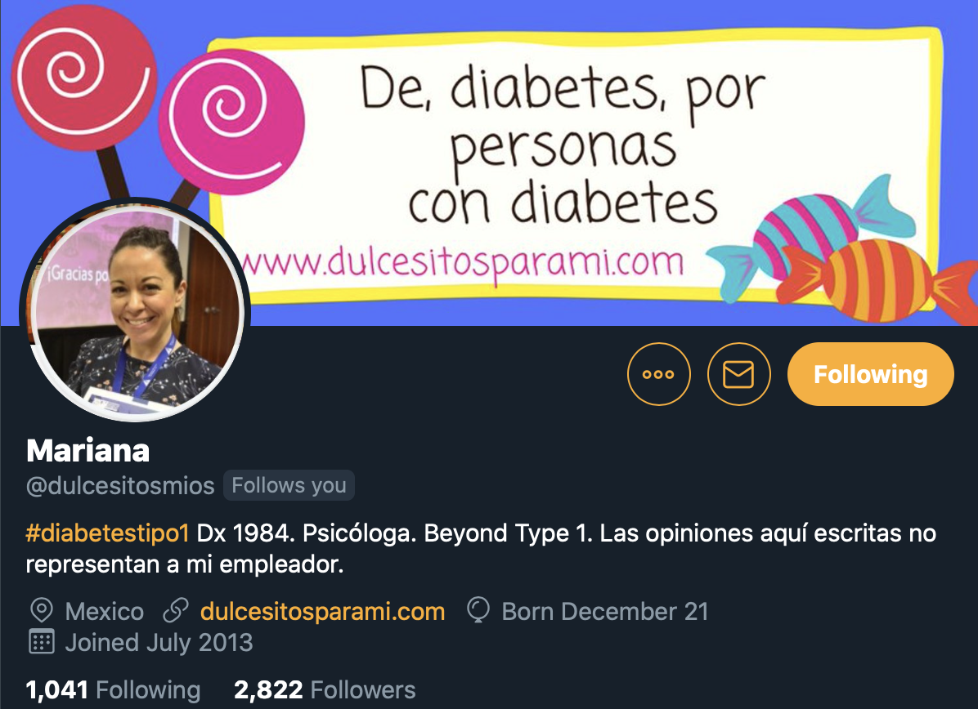
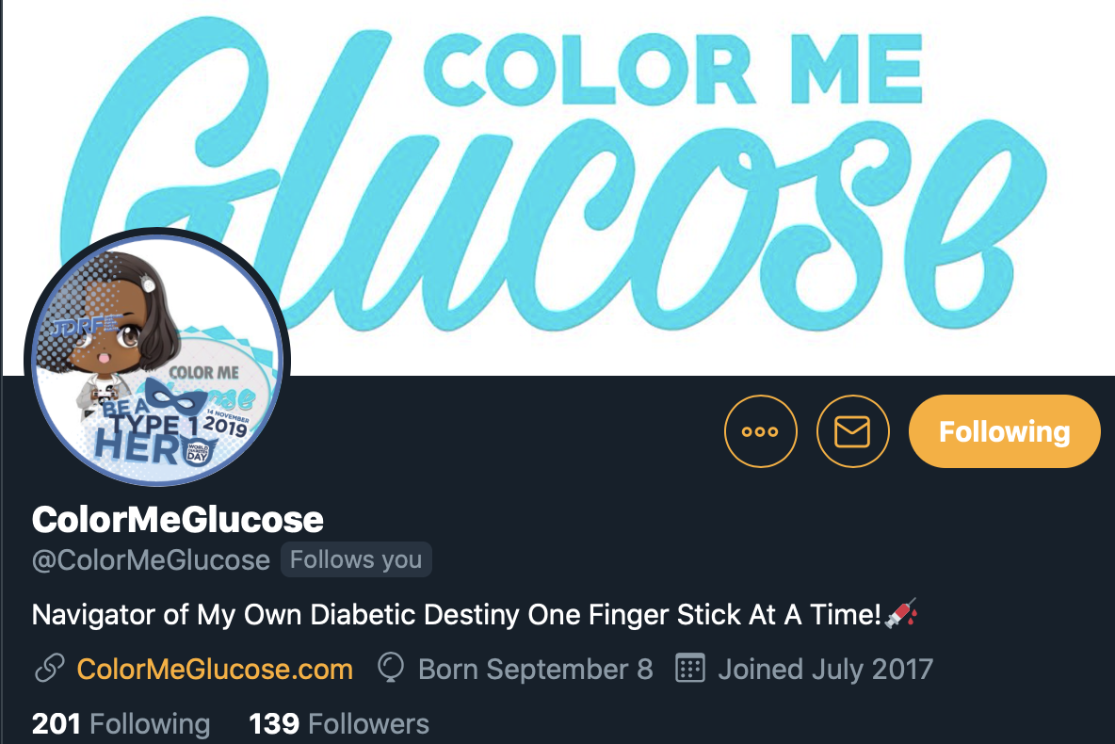
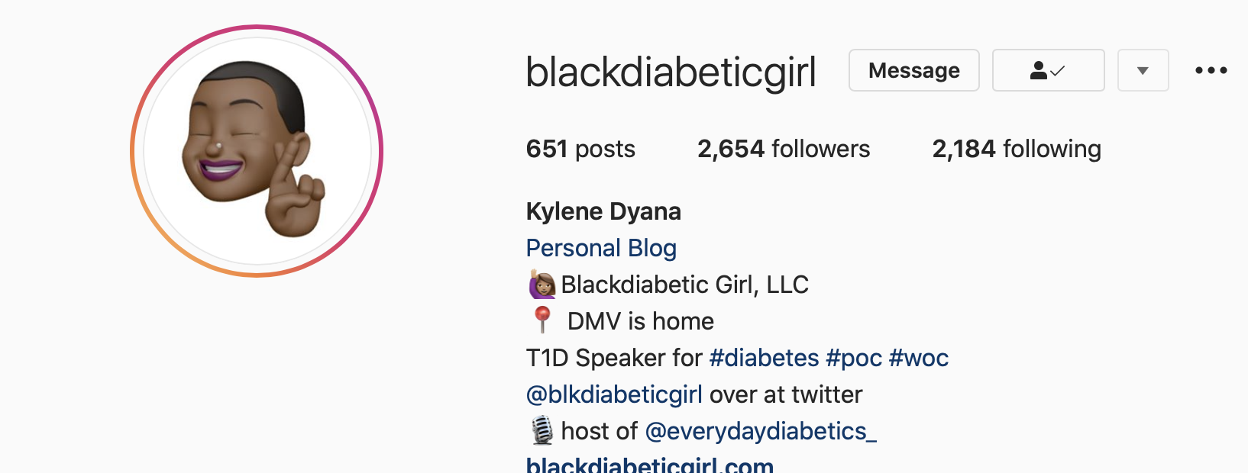
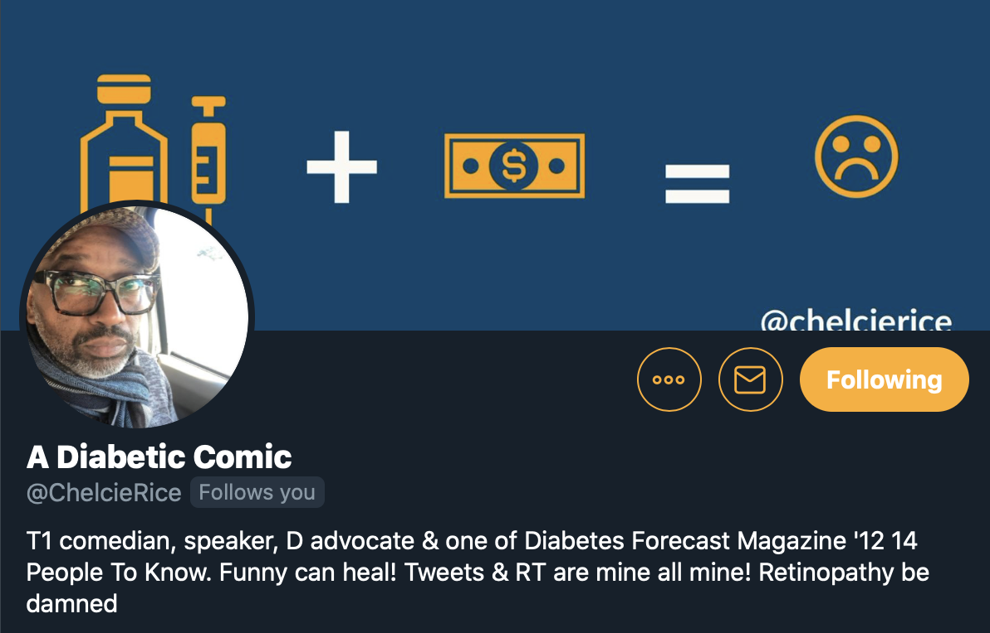
People to Follow

Slide 11
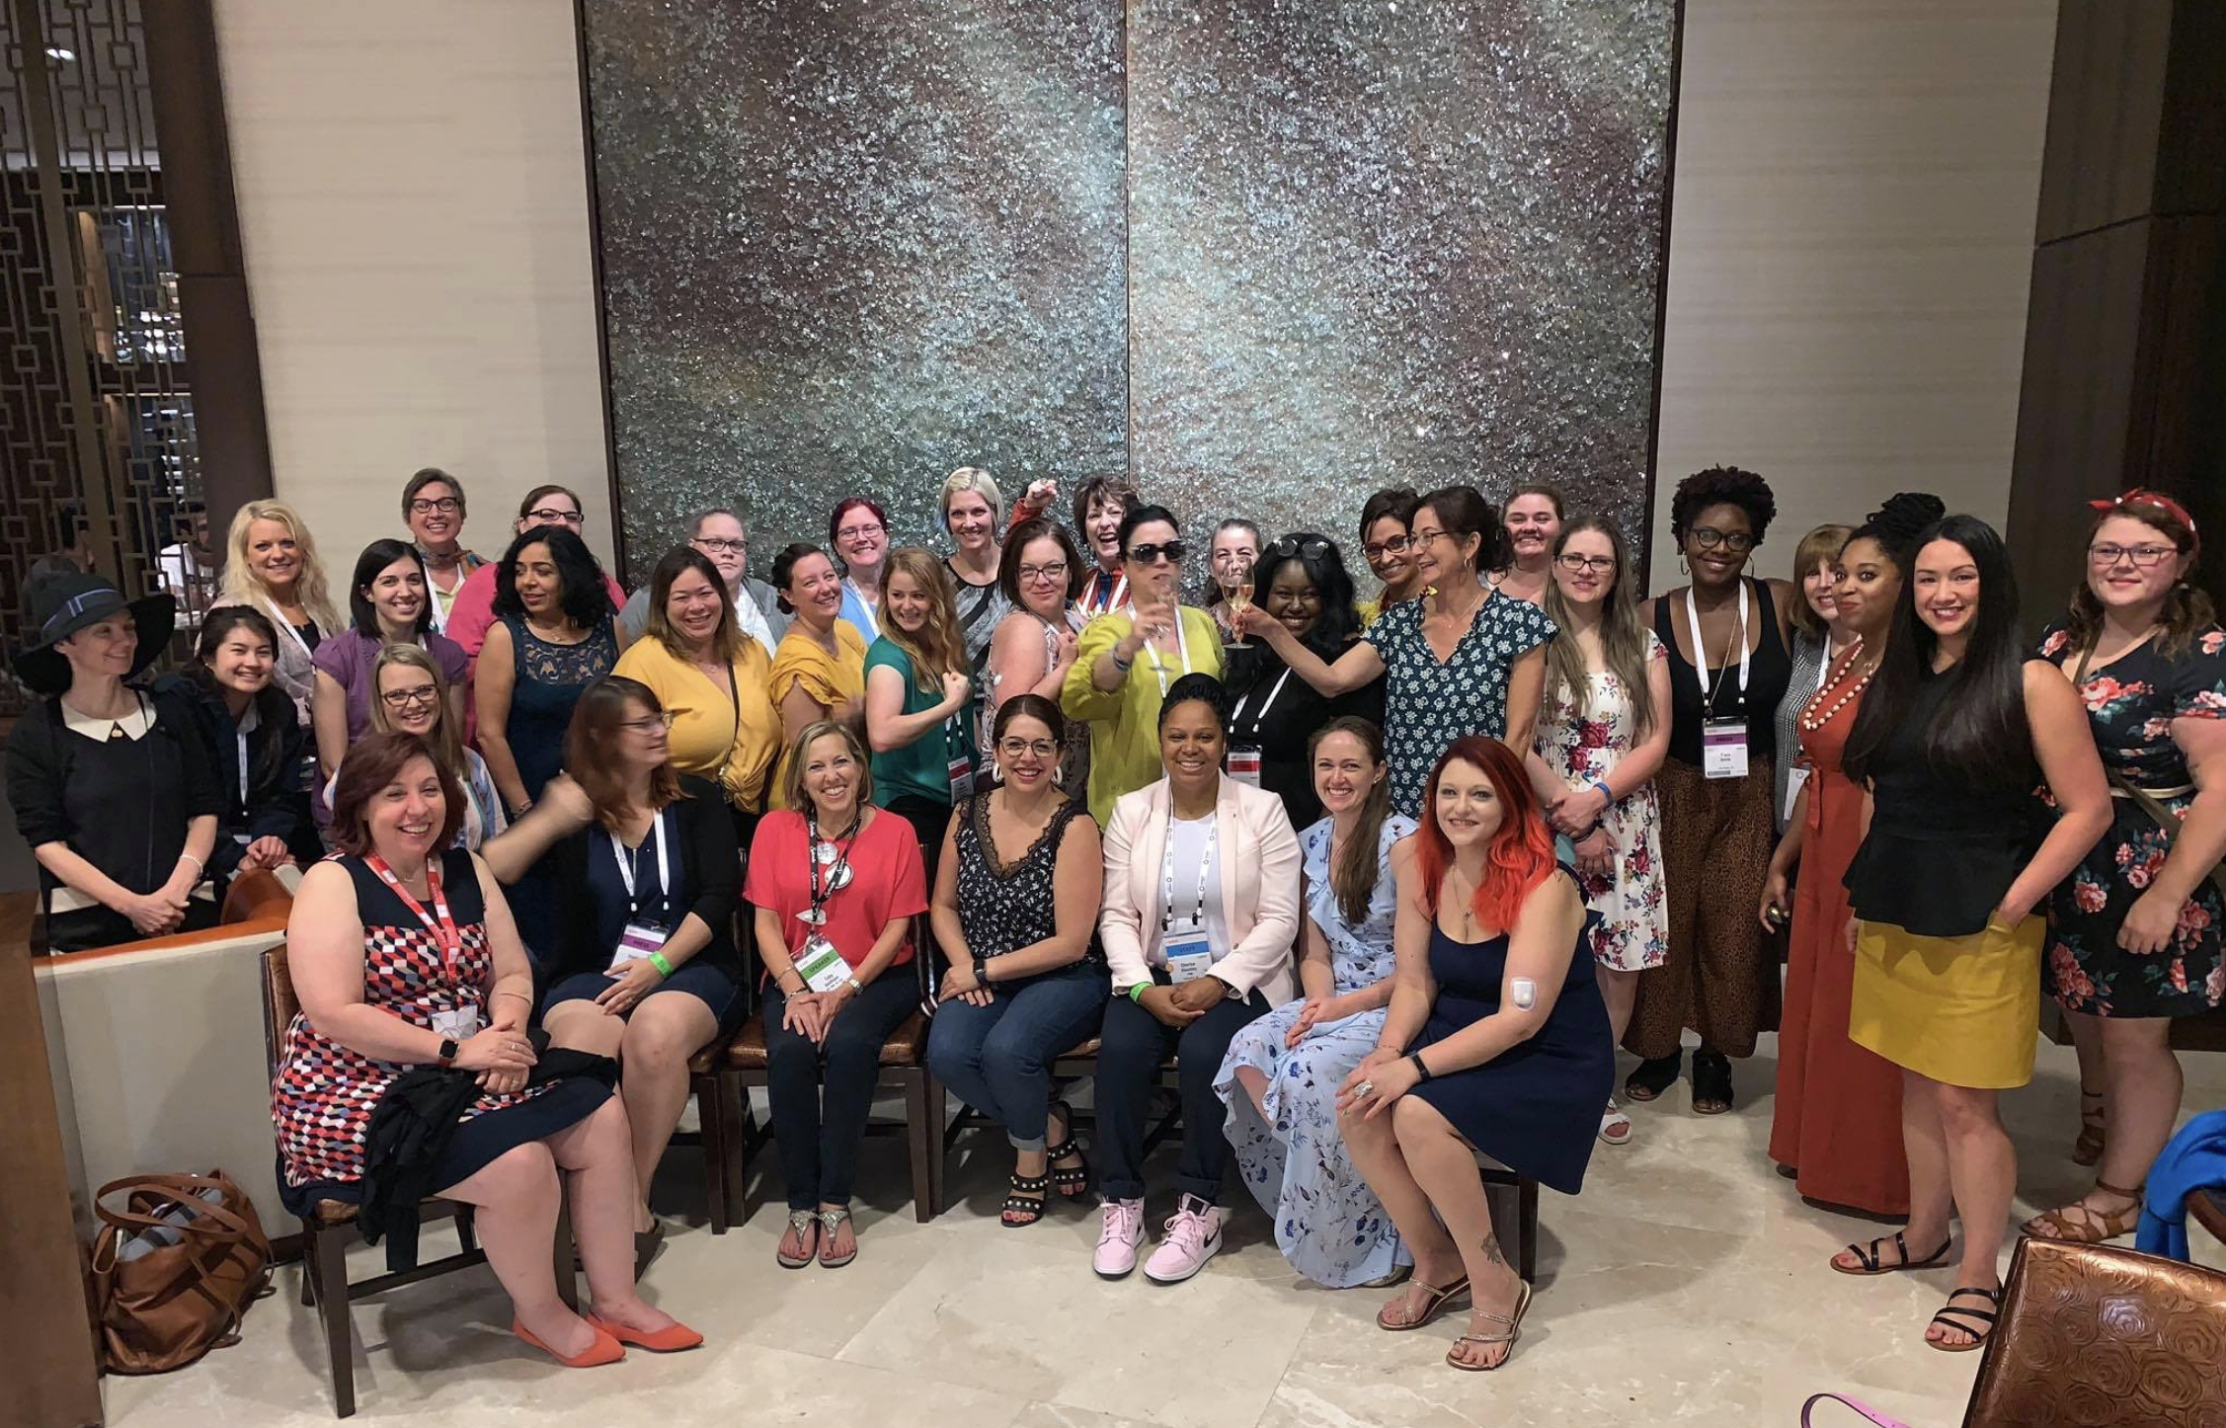
DSMA Meet-up AADE 2019 Houston, TX

Slide 12
“When we share more stories from more people, we have a chance to change the narrative landscape of diabetes. We have an opportunity to replace misconceptions with truth. Our beautifully diverse stories can make all the difference in the world. Share yours. Start now!” —Kerri Sparling

Slide 13
Diversity & Inclusion Matters

Slide 14
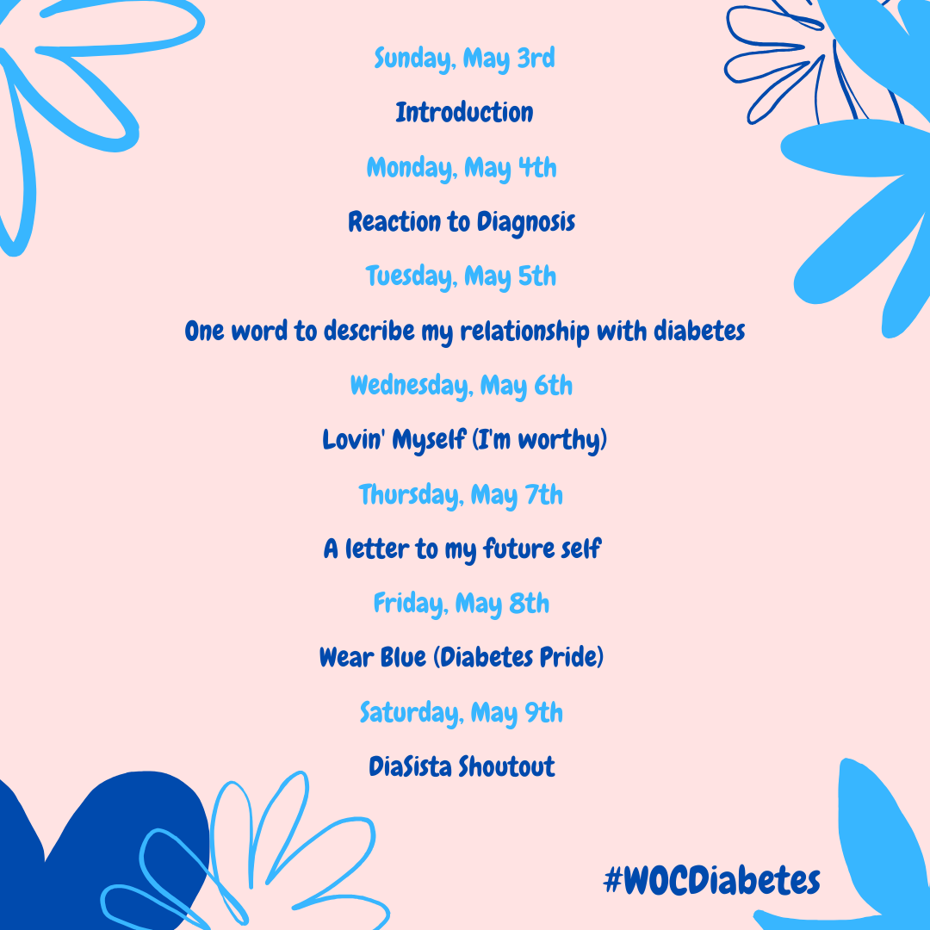

Slide 15
Thanks!
Does anyone have any questions?
Cherise.Shockley@gmail.com
Twitter and Instagram: @SweeterCherise

