Slide 1
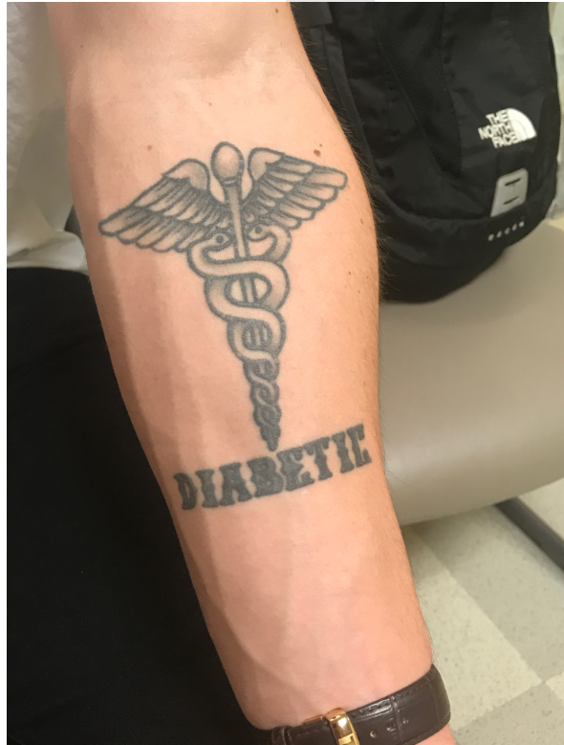
Keynote: T1D Today
Irl B. Hirsch, MD
Professor of Medicine
University of Washington

Slide 2
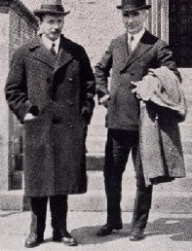
To Appreciate T1D Today, You Need To Know a Bit of History…

Slide 3
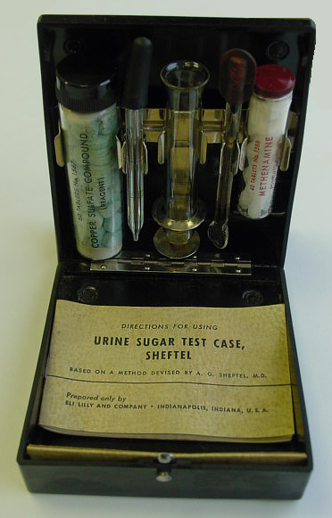

Slide 4
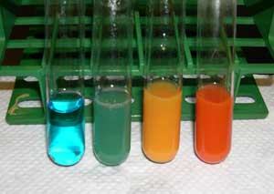
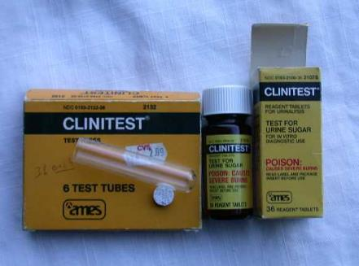
Monitoring Glycemic Control: Urine Glucose
In 1941 Clinitest® effervescent urine sugar testing tablets launched by Miles Laboratories
0%
2%

Slide 5
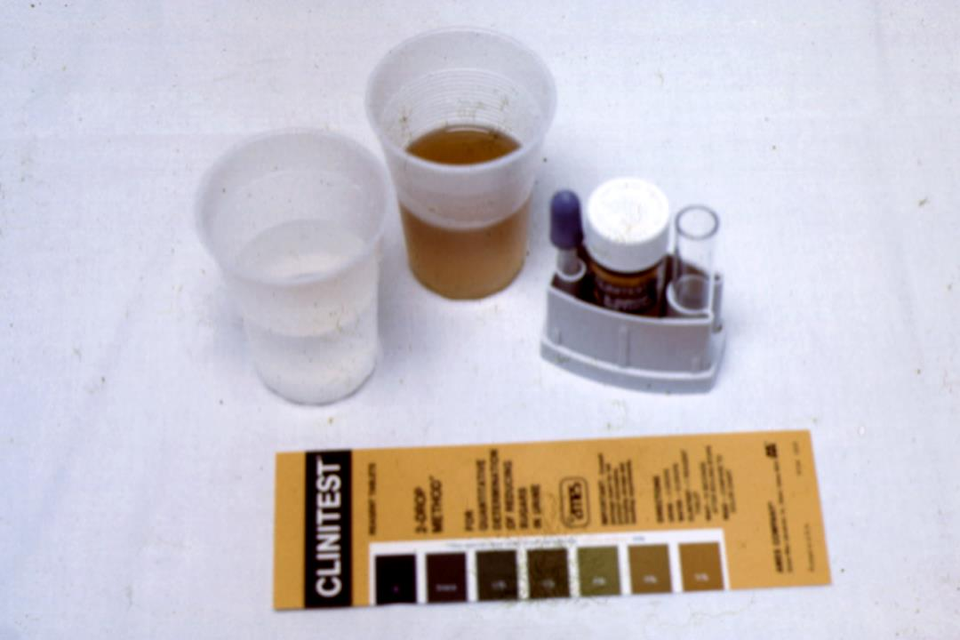

Slide 6
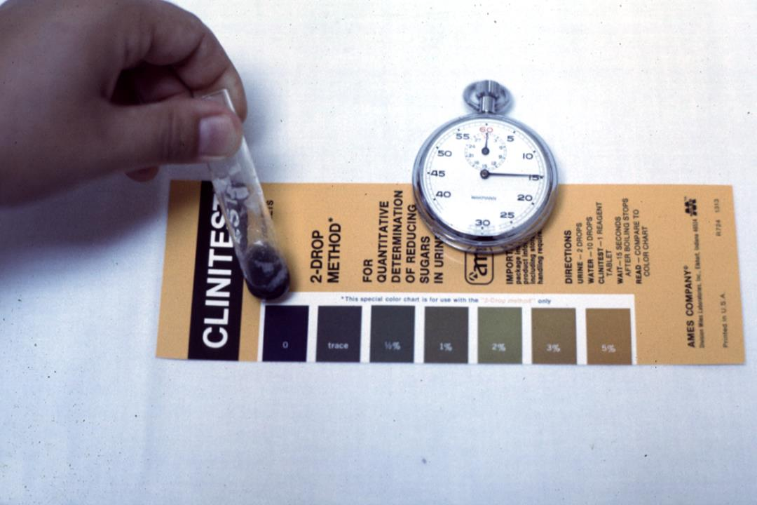

Slide 8
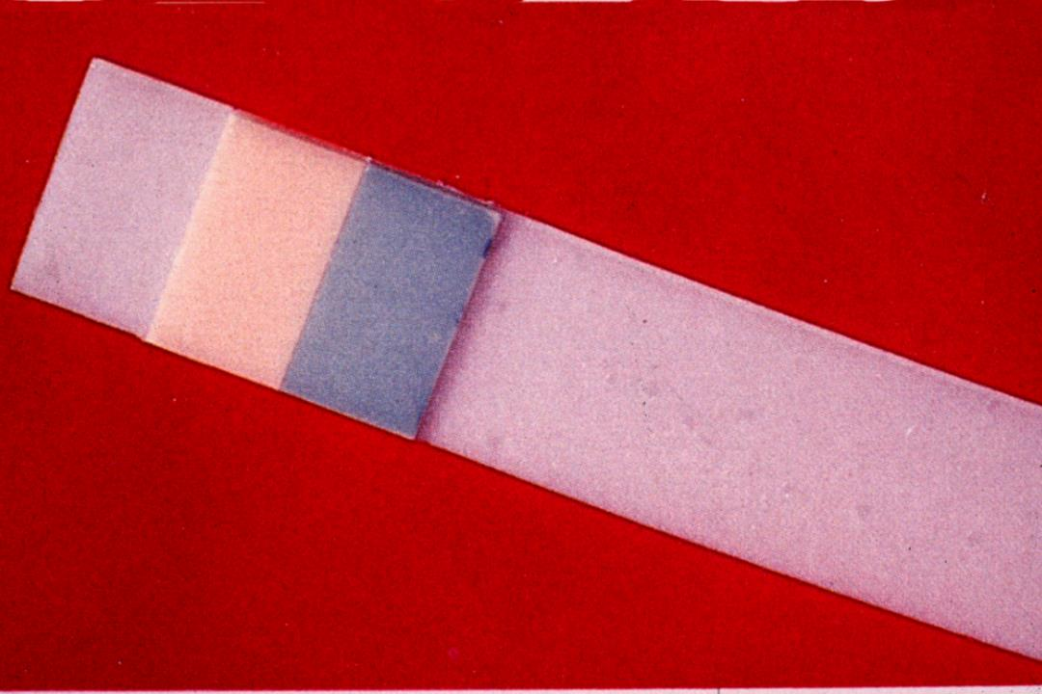

Slide 9
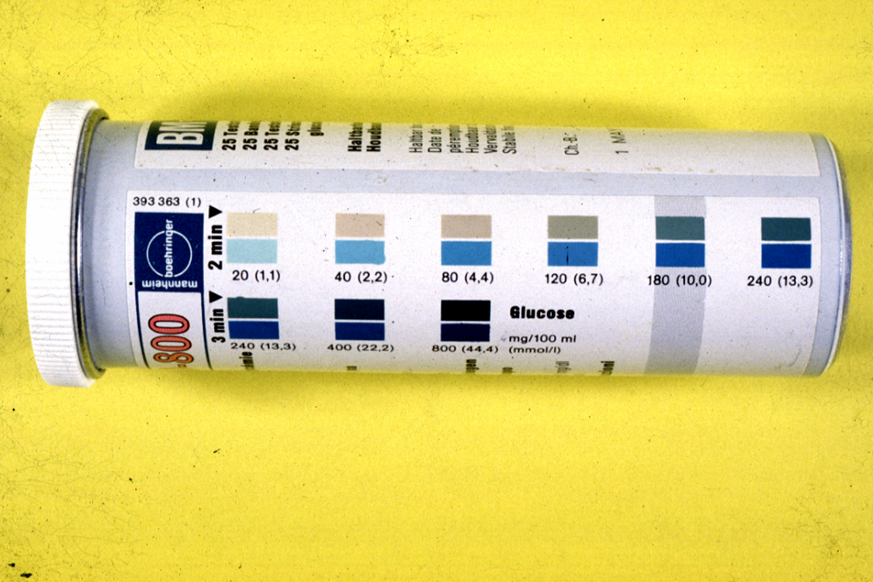

Slide 10
Why did fingerstick glucose testing become so popular?

Slide 12
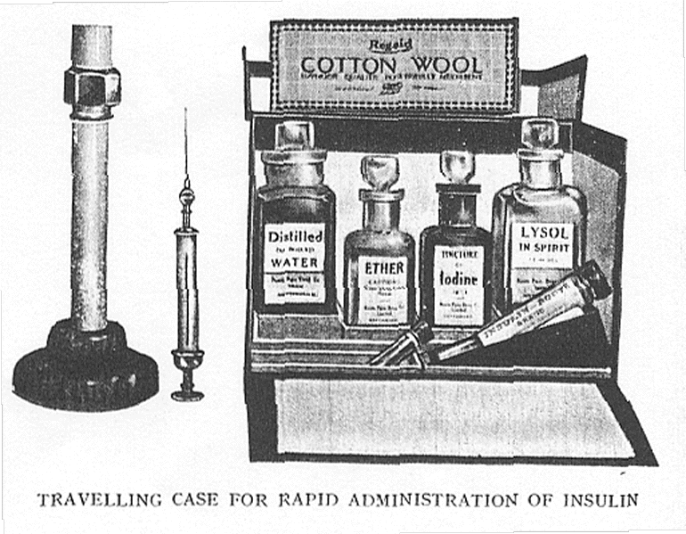

Slide 13
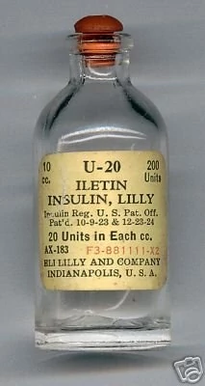
RD Lawrence, 1925
“The temperament and usual habits of the patient should be considered in the type of treatment chosen and our object should be to interfere with these as little as is compatible with health… I know that full physiological control of severe diabetes – the most continuously normal blood sugar and the least hypoglycaemia – can be best obtained with 4–6 small injections of soluble insulin in the 24 hours…
RD Lawrence. Diabetic Life, 1st edn. London: J & A Churchill Ltd, 1925

Slide 14
The History of NPH Insulin
Hagedorn and Krogh obtained the rights for insulin from Banting and Best in 1923 to form Nordisk Insulin laboratorium, a non-profit company
Hegedorn and Jenssen discovered that the effects of injected insulin could be prolonged by the addition of protamine obtained from the semen of river trout
Insulin added to the protamine, pH brought to 7.0, and protomine zinc insulin was introduced in 1936 (24-36 hours)
1946: crystals of protamine formed and when mixed with insulin formed NPH, introduced in 1950

Slide 15
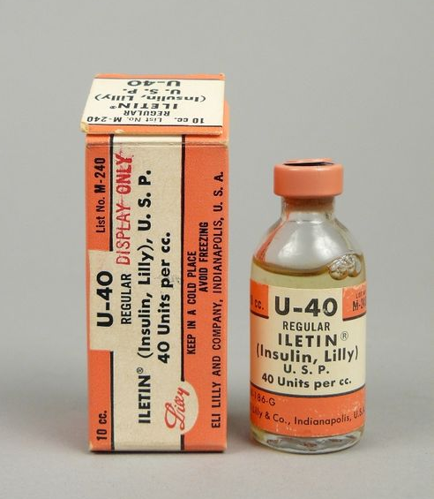
Insulins: 1950s – 1970s
1951: addition of zinc at different concentrations without protamine: semi-lente, lente, ultralente insulins
T1D: 1950s-1960s: with longer-acting insulins most with T1D treated with one shot/day assessed with urine glucose testing
1960s-1970s: Jackson and Guthrie advocate for twice daily injections to better control T1D
1962
Pre-1970s insulin: thousands of impurities per pmol/L; resulted in allergies and lipoatrophy; 1974-purified insulins at 1 pmol/L

Slide 16
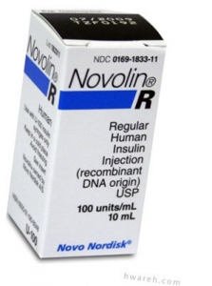
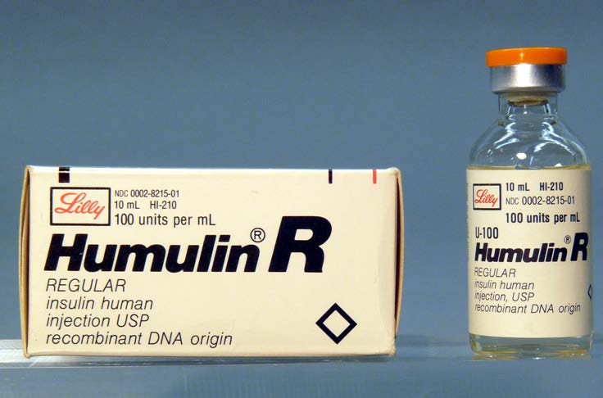
1982: Human Insulin

Slide 17
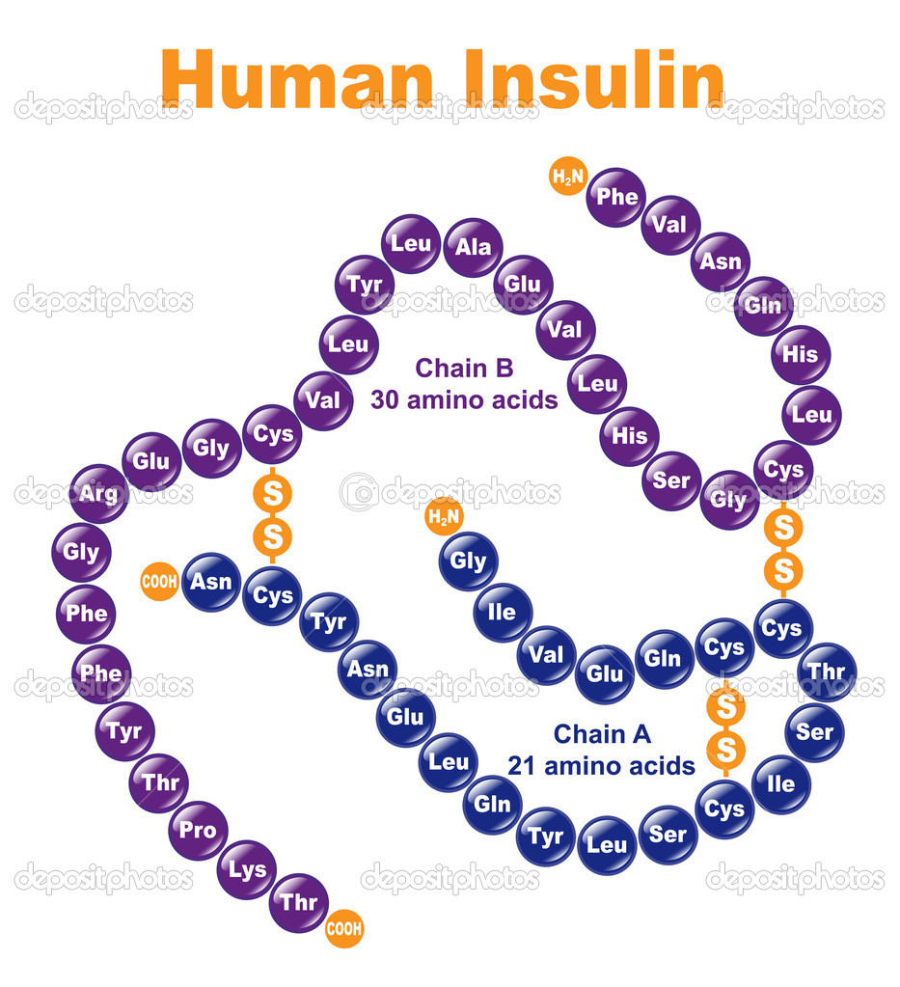
The Introduction of Insulin Analogues
1996 insulin lispro, 2000 insulin aspart, 2008 insulin glulisine, 2018 FiAsp
2001 insulin glargine, 2005 insulin detemir, 2015 insulin degludec
So why in 2019 the resurging interest in human insulin?

Slide 18
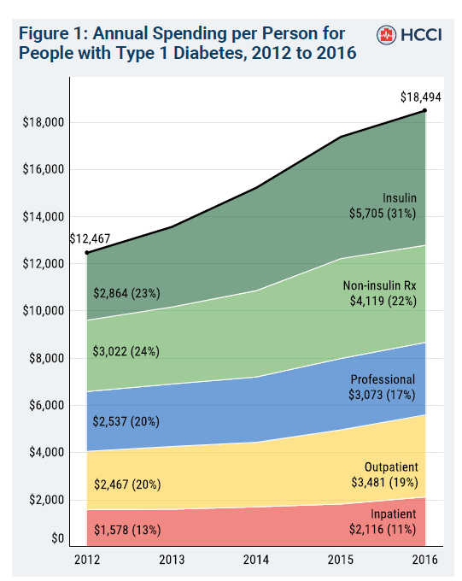
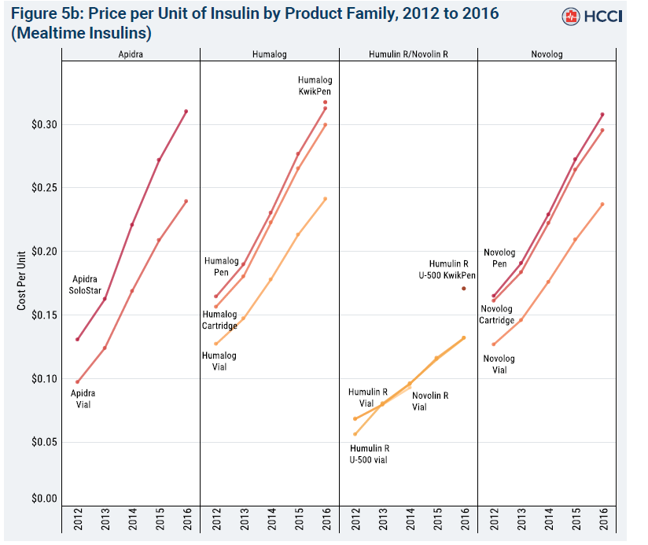
Insulin accounted for 47% of the $6027 increase in total per-person spending over this period
Health Care Cost Institute: Spending on Individuals with Type 1 Diabetes and the Role of Rapidly Increasing Insulin Prices. 2019

Slide 19
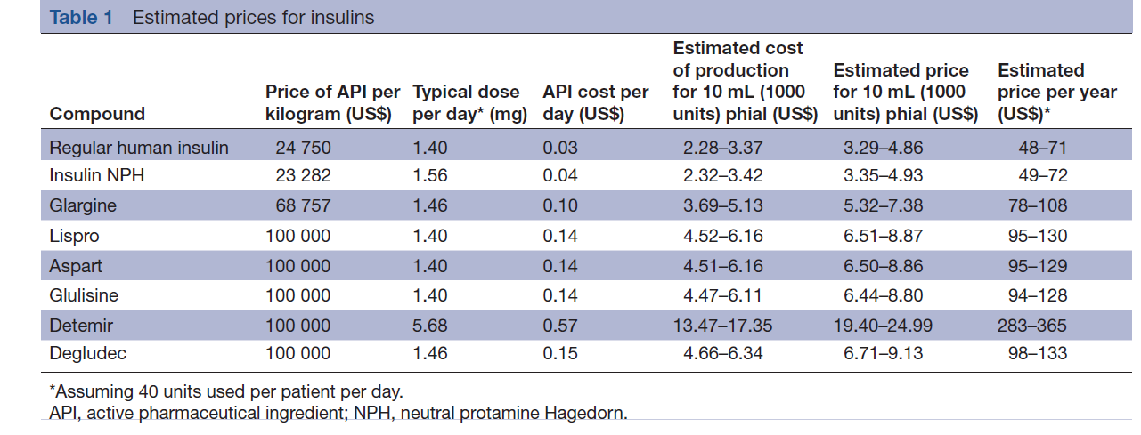
Why Is Insulin So Expensive in the US?
Extremely complex topic, including the fact list prices are exaggerated to keep up with rebates for the “middlemen” the PBMs.
The US is the only country in the world where insulin (like all drugs) is privatized, without government negotiations (some exceptions)

Slide 20
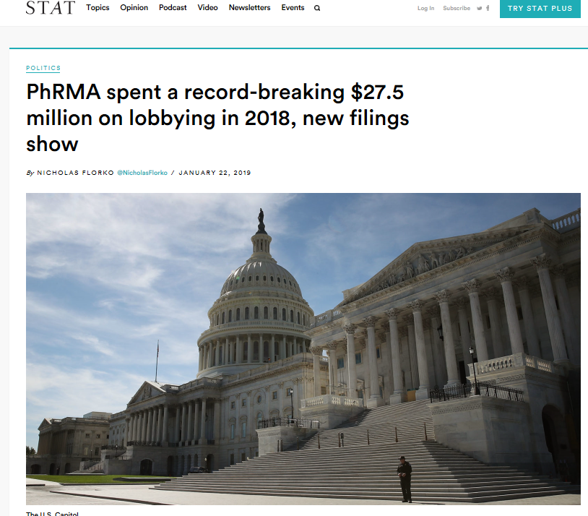
Why Nothing Will Change Anytime Soon
What now happens when asking grade schoolers the following question:
“What do you want to be when you grow up?”
Johnny: a doctor!
Mary: a lawyer!
Donald: a middle man!

Slide 21
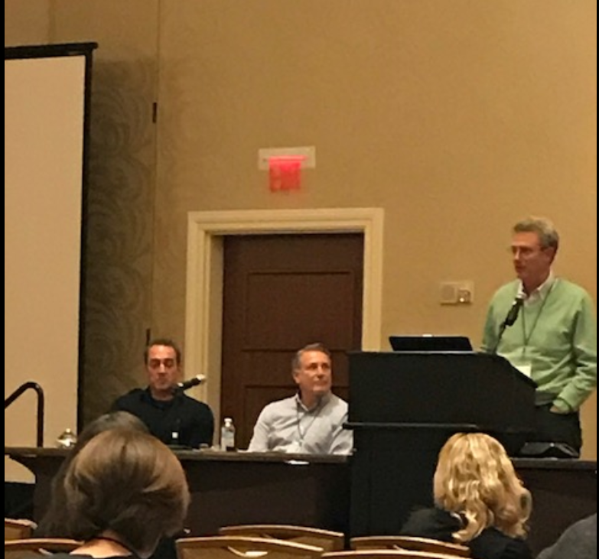
T1D in 2019
Funding of research:
NIH (mostly NIDDK), JDRF, HCT

Slide 22
So What Does T1D Look Like in 2019?
Many with T1D Are Overweight /Obese

Slide 23
T1D in 2019
CGM Use Has Increased Substantially

Slide 24
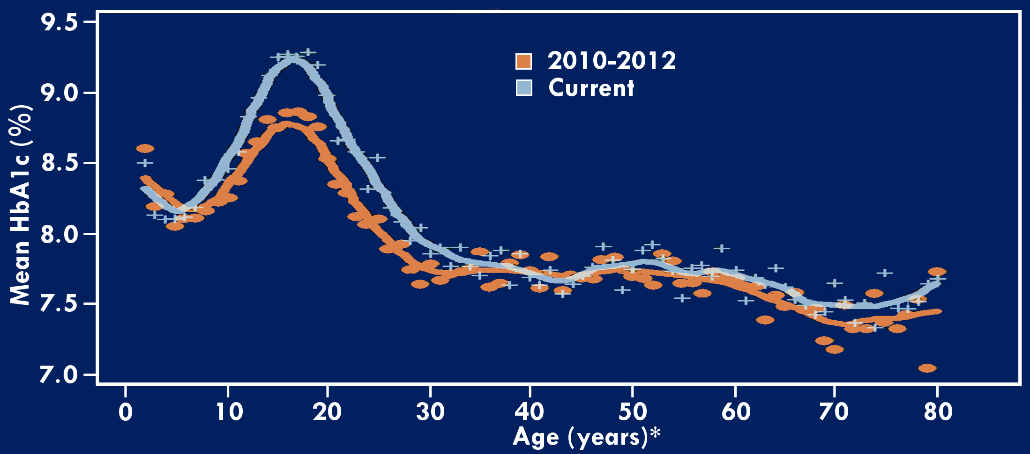
Average HbA1c by Age: 2010-2012 and Current
*≤2 years old and ≥80 years old are pooled

Slide 25
Occurrence of Severe Hypoglycemia by CGM Use Status
1 or more SH events (seizure/LOC) reported by participant in past 3 months

Slide 26
Some Good News (Finally): Diabetes Complications
The introduction of home blood glucose monitoring (to me) was the single (often unrecognized) event that changed the natural history of T1D.
Diabetic retinopathy is now extremely rare in children and vision-threatening retinopathy is now rare in adults in the US with T1D
Diabetic Kidney Disease is also becoming less common and while HbA1c, longer duration of diabetes, age, and hypertension continue to be risk factors, like all complications low socio-economic class and mental health challenges remain major risk factors.
While traditional factors for cardiovascular disease continue in T1D, any DKD remains a strong risk for heart attack and stroke.

Slide 27
To End in 2019:
Can allopurinol (an old generic drug used to treat gout) be used to slow down or stop diabetic kidney disease in T1D?

Slide 28
More “T1D Today”: What You Need To Know For Your and Your Family
“Dr. Hirsch, my HbA1c sucks”
19 y/o college student, Dec, 2018
My response:
“Indeed, A1c sucks”

Slide 29
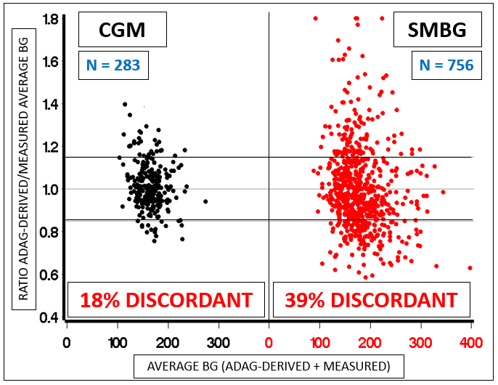
ADAG DISCORDANCE BY GLUCOSE MONITORING TECHNOLOGIES
In the UW Diabetes Care Center, even with CGM 18% of HbA1c levels “don’t work”.
ADA Sci Sessions 12-OR, 2018

Slide 30
GMI: a new metric calculated by CGM-based formula from a population of of mean glucose data
Minimizes the main limitation of A1C (wide variability of mean glucose for any A1C)
With GMI, our “discordant” A1C issue is resolved.
Diabetes Care 2018;41:2275–2280

Slide 31
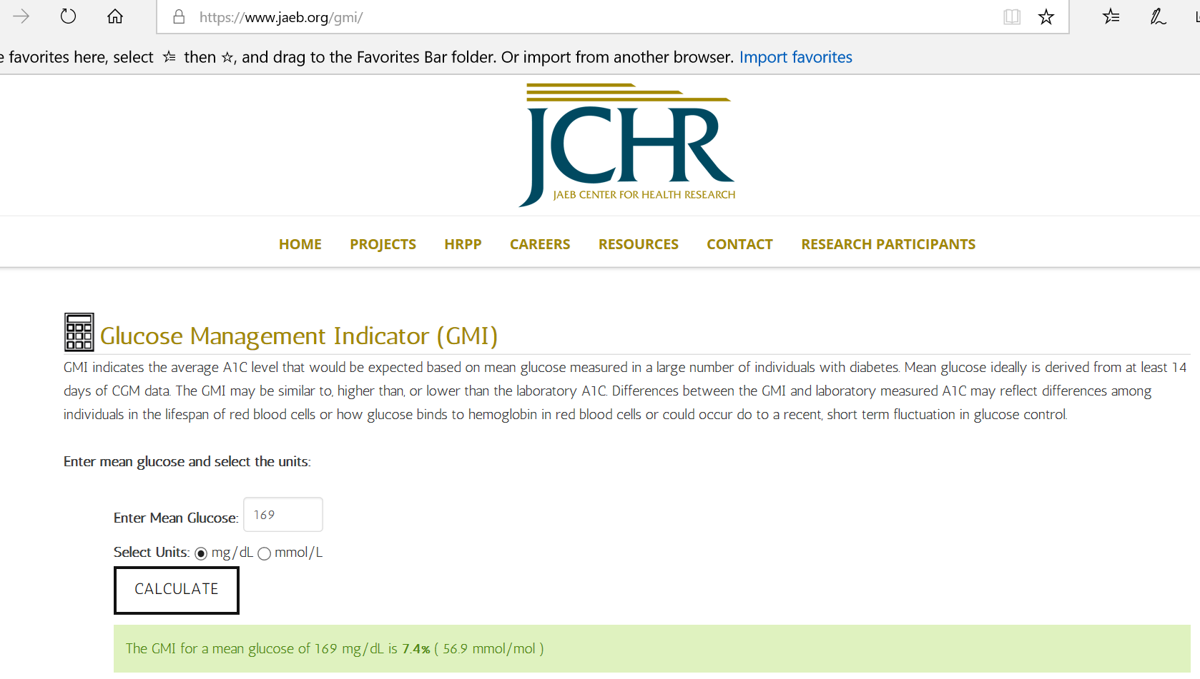
31

Slide 32
So What Is a Better Option With All of These Problems with A1C?
A. Fructosamine
B. Glycated Albumin
C. 1,5 Anhydroglucitol
D. Time in Ranges on CGM
My opinion: I’d rather speak in “time-in-range-ese” than “HbA1cese” because the units mean the same thing no matter the co-morbidity, race, and even political party

Slide 33
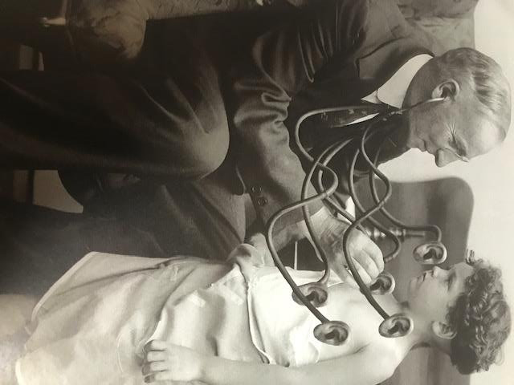
T1D in 2019:
Using New Technology is Not Always Easy

Slide 34
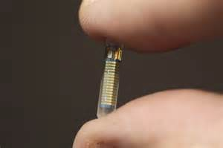
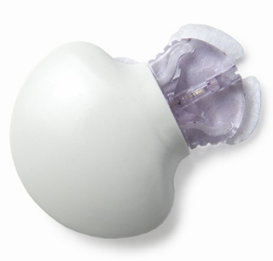
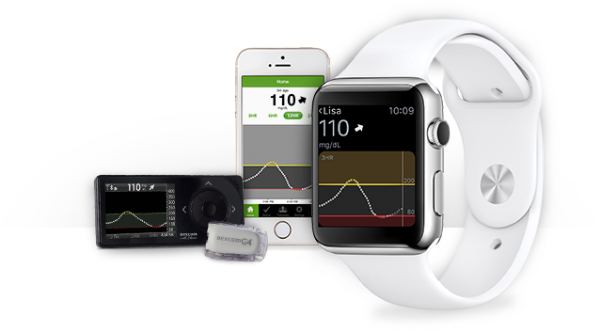
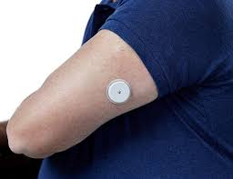
Using CGM to measure time-in-range (defined a 70-180 mg/dL)

Slide 35
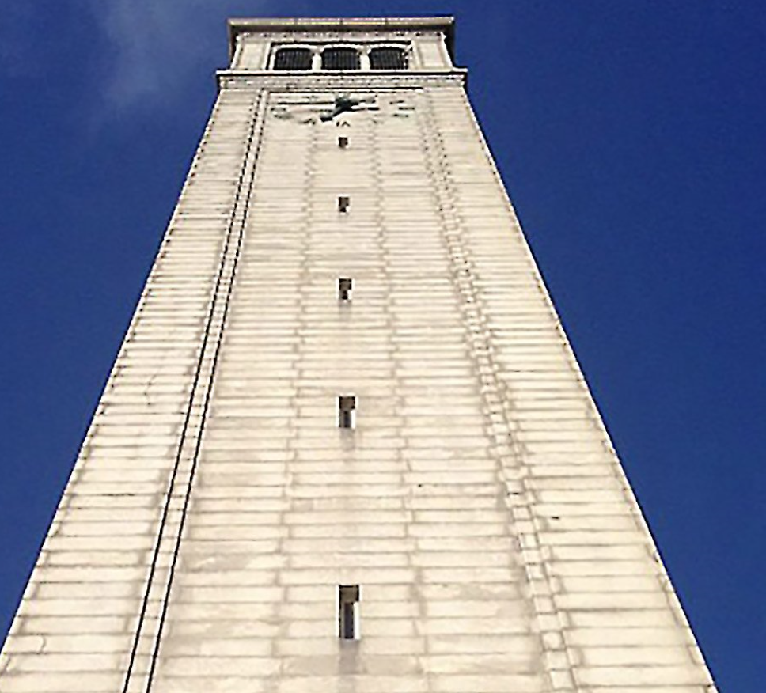
The Biggest Problem-Until Now
The “Ivory Tower” academics would not accept TIR as there were no studies correlating TIR with complications.
Not any more

Slide 36
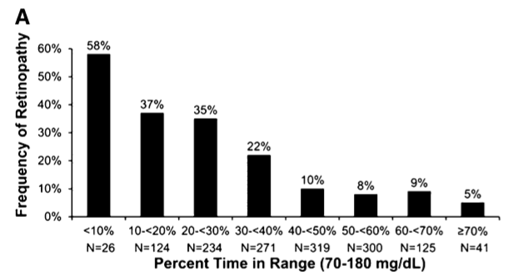
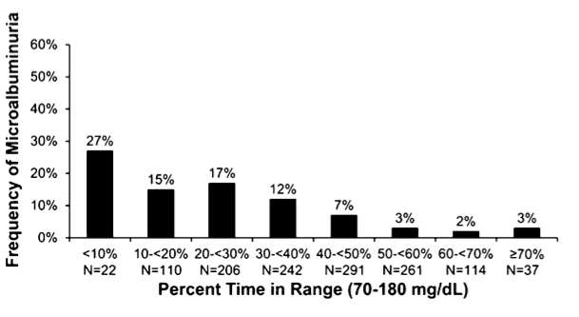
TIR and Microvascular Complications (T1D, DCCT)
Retinopathy
Nephropathy
For every 10% lower TIR, retinopathy increased by 64% and microalbuminuria increased by 40%
Diabetes Care 2019;42: 400-405

Slide 37
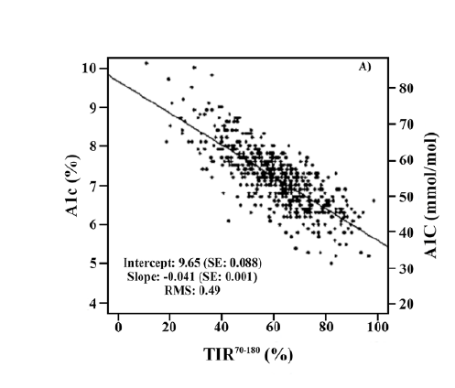
Relationship between TIR and A1C in T1D
Beck RW, Bergenstal RN, Cheng P, et al: JDST e-pub Jan 13, 2019

Slide 38
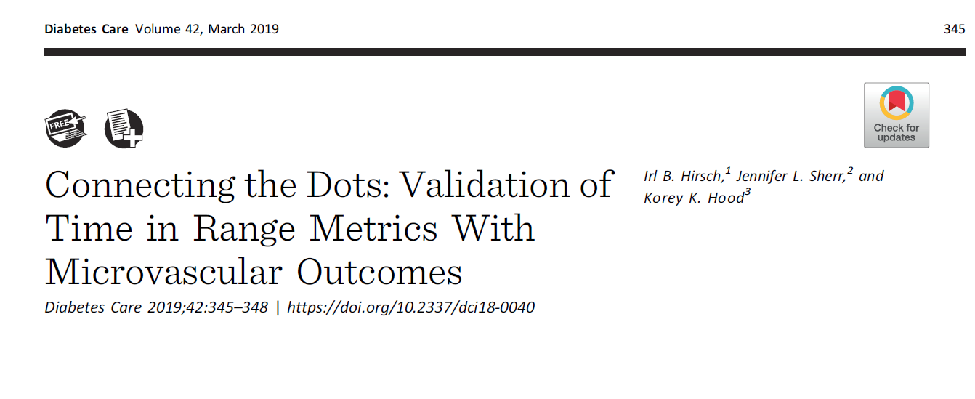
“While to some it may seem like A1C is ‘outdated’, we would maintain that this biomarker should continue to be used as a tool for both clinical care and research. A1C has a proven track record but provides different information than TIR, thus a combined outcome for these two metrics seem justified. In addition, particularly for clinical care, it is not realistic to assume CGM will become so popular that there would not be a need for A1C.”

Slide 39
International Consensus on TIR, ATTD Feb 2019, Berlin Germany
Diabetes Group | Time-in-Range Target | Time Below Range Target | Time Above Range Target
Diabetes type 1 & 2 | ≥70% (Range: 70-180 mg/dl) | <4% time below 70 mg/dl <1% time below 54 mg/dl | (minimize time in hyperglycemia)
“Frail” PWD type 1 & 2 | ≥50% (Range: 70-180 mg/dl) | <1% time below 70 mg/dl | ≥90% time below 250 mg/dl
Type 1 pregnancy | ≥70% (Range: 63-140 mg/dl) | <4% time below 63 mg/dl | <25% time above 140 mg/dl
Type 2 pregnancy/ gestational diabetes | 85%-90% (Range: 63-140 mg/dl) | <4% time below 63 mg/dl | <10% time above 140 mg/dl

Slide 40
“Adjunctive Therapy”: What Do You Need To Know About These Drugs Approved for T2D?
SGLT2 Inhibitors
Act by increasing kidney’s loss of glucose in the urine
Effective at lowering A1C, weight, and insulin dose
Urinary infections (especially vaginal yeast infections) due to high glucose in the urine
Major concern: DKA at a higher rate than the general T1D population
March 22, 2019: FDA did not approve sotagliflozin for T1D

Slide 41
GLP-1 Receptor Agonists
Approved for T2D by daily or weekly injection
Studies show minimally lowers A1C long-term unless already still making insulin
Weight loss
Awaiting data on use for preserving beta-cell secretion
Most find less variability of glucose

Slide 42
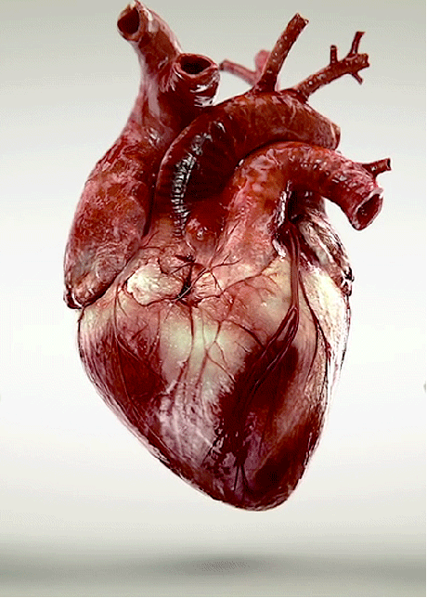
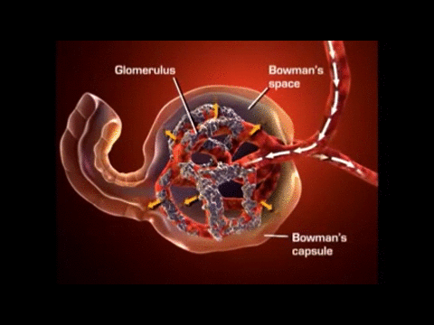
What We Know About SGLT2 I’s and GLP1’s in T2D

Slide 43
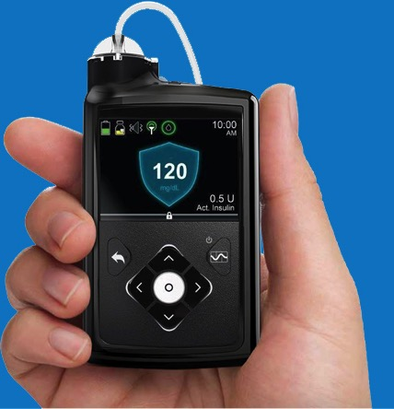
Automated Insulin Delivery: Now And the Future
Raise your hand if you are on or have tried the Medtronic 670G
What are the Pros and Cons of our first HCL System?

Slide 44
Do the Pros Outweigh the Cons? For Many “YES”
Cons
Still need to do calibrations
Insulin dosing algorithm too conservative for many
Initially a large learning curve
Pros
Most with higher A1C levels can come down close to 7%
If done correctly hypoglycemia is minimal

Slide 45
Medtronic Hybrid Closed Loop- RESEARCH Study
WHO qualifies for the study?
Ages: 21-80
Using Lantus, Trujeo, and Tresiba in the last 3 months with or without CGM.
Multiple Daily Injections in the last 3 months.
People with Type 1 Diabetes
WHAT are we researching?
1 year study
Post FDA approved study looking at the efficacy of the Medtronic 670G Hybrid Closed Loop System.
WHEN is this happening?
NOW! MANY benefits to participate in research!
WHERE will this study happen?
At the South Lake Union Diabetes Institute
Please contact Julia Chang if you are interested in this study!
(P) 206-598-8150 (E) juliac95@uw.edu@uw.edu

Slide 46
What We’ve Learned in the UW DCC
Bolus doses need to be more aggressive than what we used in open loop pumps
Typically only 40-45% of total insulin is “basal insulin” (micro-boluses)
While true “active insulin” is 5-6 hours with Humalog and Novolog, to get best results with the 670G we typically get down to 4 or often even 3 hours
IMPORTANT: in this pump, active insulin only pertains to the correction doses
Even more important: correction targets can’t be changed: target always at 150 mg/dL
My goal for most patients is to get average glucose to about 140 with less than 4% in the hypoglycemia range (below 70 mg/dL)

Slide 47
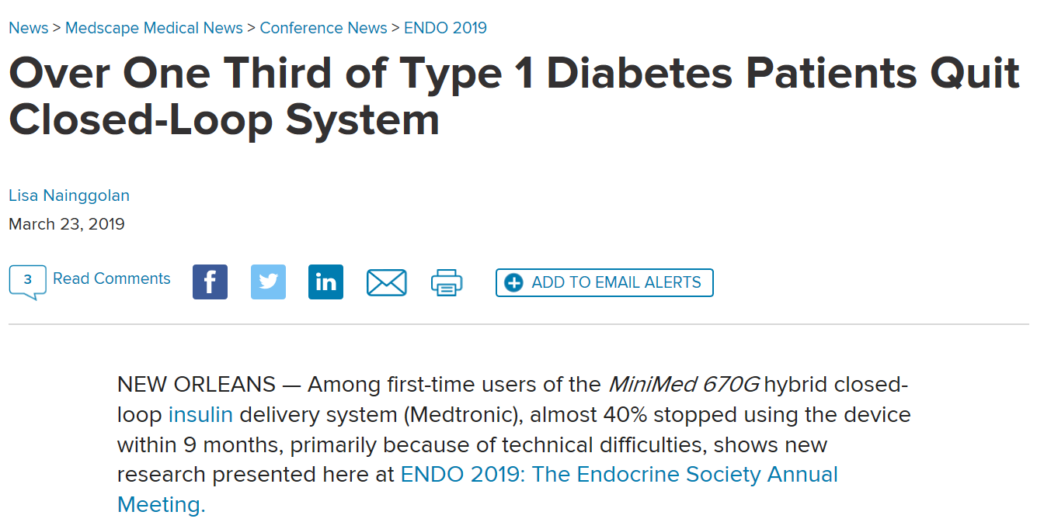
Author Gary Goodwin, Boston Children’s Hospital: "For this to be available and practical for the average type 1 diabetes patient, we need more user-friendly technology…"
Anders Carlson, IDC Minneapolis: "Automated insulin delivery is the future, but the sensors need to get better.”

Slide 48
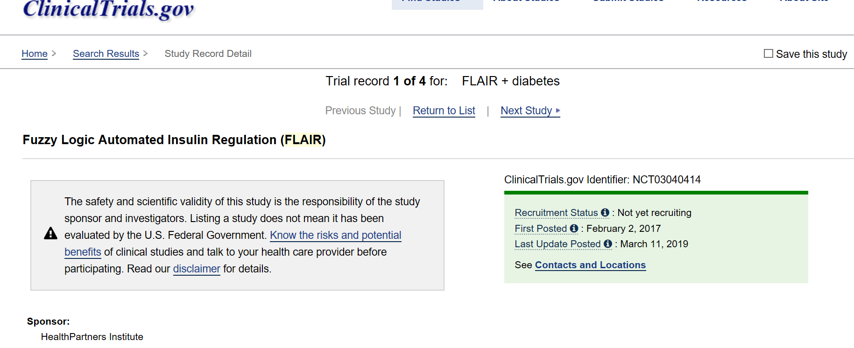
7-day infusion set

Slide 49
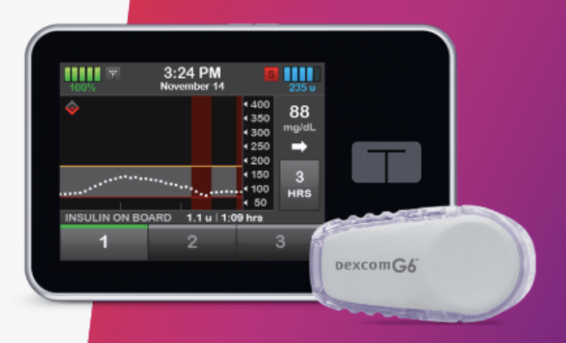
More AID: Tandem
Control-IQ: hybrid closed loop with Dexcom G6 and TypeZero algorithm integrated into t:slim 2 pump (auto-correction boluses
US launch scheduled later this year

Slide 50
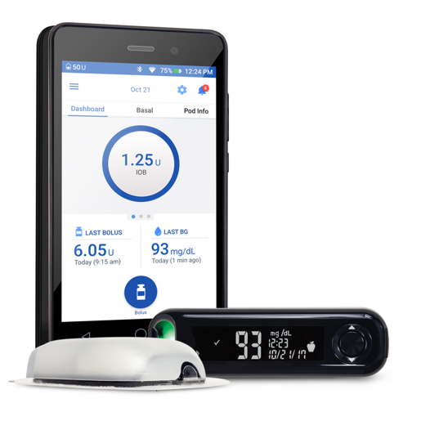
Omnipod DASH
Integrated glucose testing: Freestyle with current system, Ascensia Contour wireless with DASH
Optional bolus presets for Small, Medium, Large meals
Omnipod DASH will have Calorie King integration

Slide 51
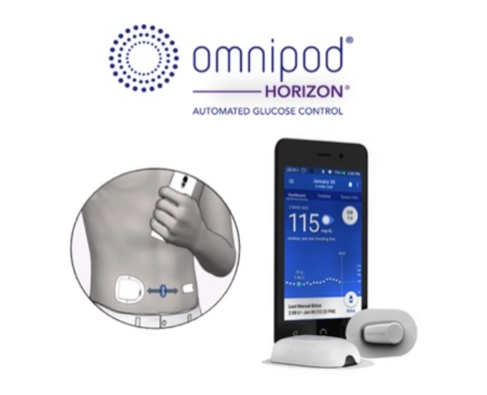
OmniPod AID: Horizon
Insulet’s Horizon hybrid closed loop is now expected to launch in second half of 2020, with direct user smartphone control

Slide 52
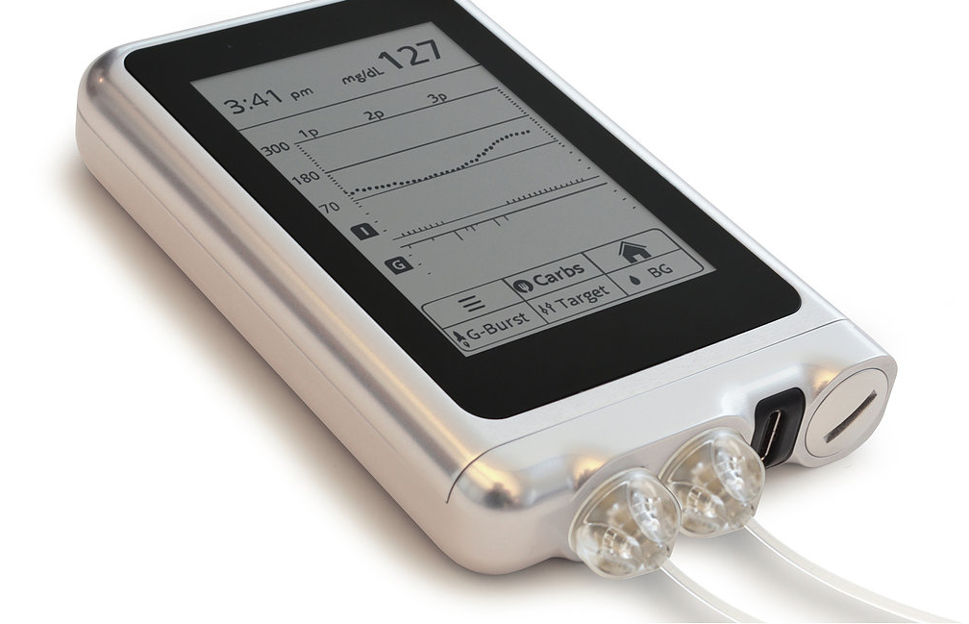
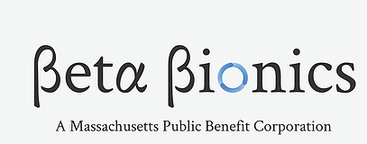
Bionic Pancreas:
Next Generation “iLet”
GLUCAGON
INSULIN

Slide 53
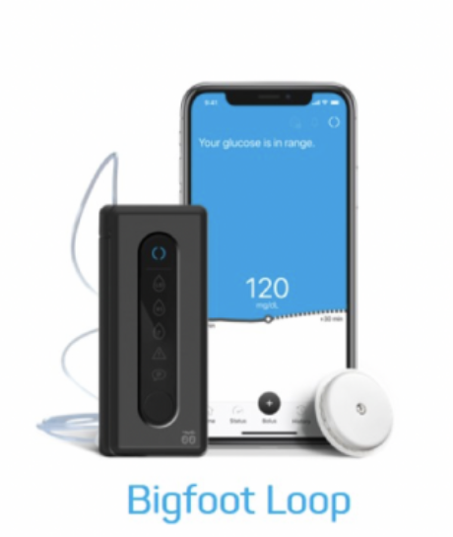
Bigfoot Biomedical
Disposable pump body married to durable controller with an embedded control algorithm
Pump talks directly to next generation FreeStyle Libre CGM.
Smartphone to serve as the window to the system and user interface.
A hybrid system that automates the delivery of basal insulin and automates updates to all insulin delivery settings by hour basal rate, insulin to cab ratio, ISF and the glucose target

Slide 54
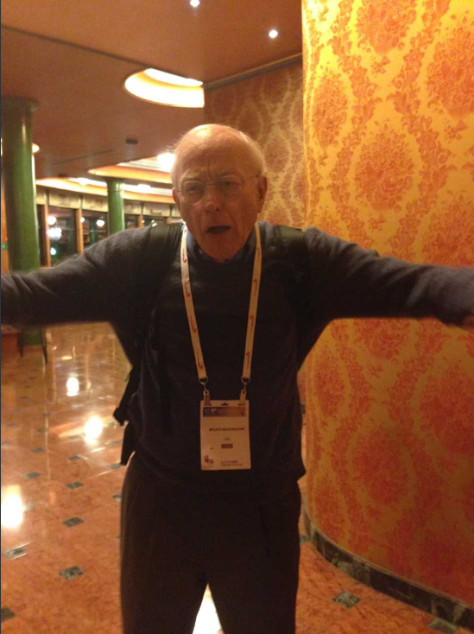
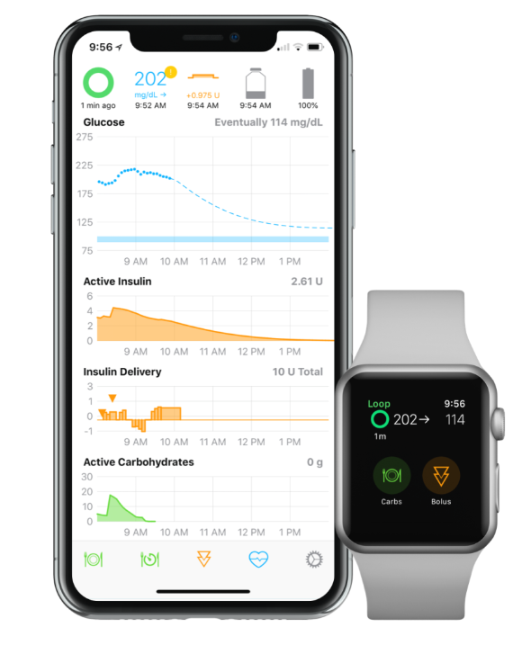
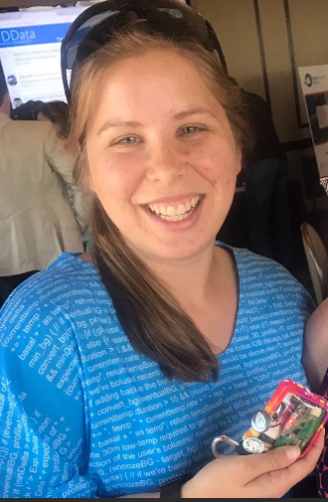
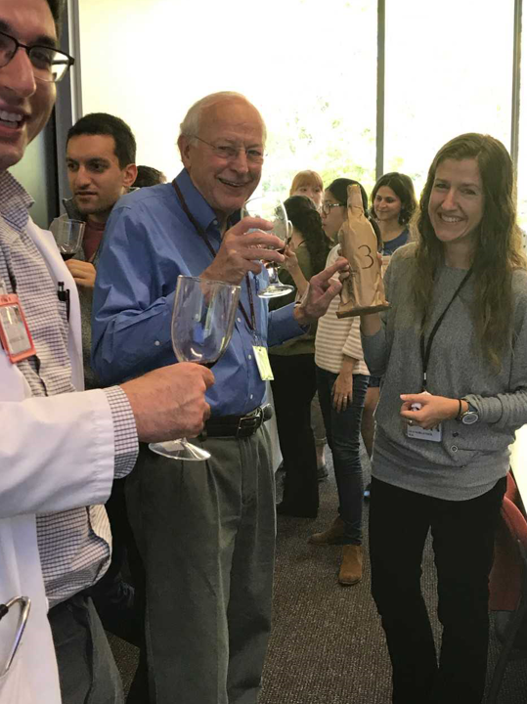
Wait A Minute! I Don’t Want To Wait!! Closing the Loop
Bruce doing his Bernie Sanders impersonation
#WeAreNotWaiting Movement
Howard Look, 3pm today
What You Should Know About DIY Closed Looping
Dana Lewis, 10:45am tomorrow
Closing the Loop: Building an Artificial Pancreas
Bruce Buckingham, 1pm tomorrow

Slide 55
Reality Check

Slide 56
Reality check
Control of T1D in the US is not good-even worse outside the US
There is still too much suffering from diabetes chronic complications
None of our new technology will help patients with major psycho-social issues which are extremely common
> 50% of adults with T1D receive their care from someone with no training in T1D (I have thought about writing a book about what I have observed)
Only about 30% of T1D individuals use pumps and that number hasn’t changed in many years
One out of 4 Americans intentionally withhold insulin due to costs, and we don’t even know how many have died due to the unaffordability of insulin

Slide 57
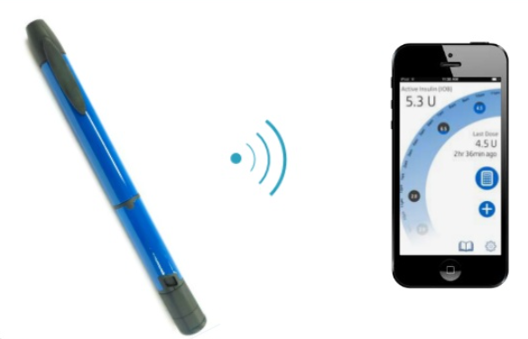
So From A Population-Point-of-View, What Will Likely be the Most Important New Advance?

Slide 58
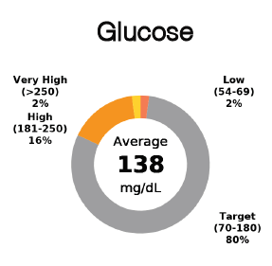
CV = 33

Slide 59
CGM and Insulin Details; For the First Time We Can See Insulin Details in Non-Pump patients

Slide 60
Smart-Pens Now Introduced in 2019 Are A Huge Benefit, The Other Reality
Due to increasing time pressures, very few non-pediatric endocrinologists have the time, infrastructure, or knowledge to read any download reports (in a 15-min or at most 20 min visit, there simply isn’t time)
My advice:
Find an endocrinologist who will look at downloads. You can always download your data from home and more of the downloads are passively uploaded to your phone. Show the data!
Find a multi-specialty team with a nurse, nutritionist, “behavioral scientist”
If not available, find someone outside of the practice who can help! It is worth the extra money

Slide 61
My Predictions (Glass Half-Full)
Access to insulin will improve, but government intervention will be required.
For now, better (and faster) insulins will continue to be developed
Adjunctive therapies will continue to be explored, and eventually will be approved by the US FDA
Our first generation automated insulin delivery systems will continue to improve
Most insulin users, including those with MDI, will have access to bolus calculators and most importantly, active insulin on board

Slide 62
More Predictions
Advocacy will prevail! Better accommodations for T1D for the very young in pre-schools and schools.
Due to the longer lifespan now in T1D, we now need to focus on advocacy for the very old: assisted living facilities and nursing homes
J Clin Endocrinol Metab 104: 1–55, 2019
On line March 23, 2019

