Slide 1
Developing Your Child’s Section 504
Presented by:
Crystal Crismond Woodward Director, Safe at School
American Diabetes Association
Children with Diabetes Friends for Life
Orlando, Florida
July 19, 2019

Slide 2
MISSION
To prevent and cure diabetes and improve the lives of all people affected by diabetes
We deliver mission through:
Research
Information & Support
Advocacy & Public Awareness

Slide 3
Federal and State Laws to the Rescue
These laws can help level the playing field and ensure a safe and fair
school environment for our children
Federal laws
Americans with Disabilities Act (ADA)
Section 504 of the Rehabilitation Act of 1973 (Section 504)
Individuals with Disabilities in Education Act (IDEA)
State laws, regulations and guidelines

Slide 4
Section 504
Covered schools: All public schools (including charter schools) and private schools (including religious affiliated) that receive federal financial assistance.

Slide 5
Under 504/ADA Schools Must:
Identify children with disabilities
Provide a “free appropriate public education” (FAPE) to each child with a disability
Educate children with disabilities with other students as much as possible;
Allow parents to participate meaningfully in decisions regarding their child’s diabetes care at school
Afford children with disabilities an equal opportunity to participate in nonacademic and extracurricular services and activities.

Slide 6
Navigating the 504/IEP Process
Parent/guardian should contact school’s 504/IEP coordinator – many times this is the school principal or guidance counselor
School may initiate if suspects a need for special education or related services
An evaluation for eligibility under 504 or IDEA will be conducted by school staff knowledgeable about your child
Once an eligibility determination has been made, the 504/IEP team will convene to develop a written plan

Slide 7
504/IEP Team
Parent/s | Student | Regular Ed Teacher/s
Special Ed Teacher | Therapists: PT, OT, SLP | Specialists: Music, Art, PE
School Nurse | Principal | Counselor
School Psychologist |  | Anyone parent wishes to attend

Slide 8
Steps to Assessment, Implementation & Evaluation
Multi-disciplinary Team
Individualized Assessment
IDEA Eligible
504 Eligible
Develop IEP
Develop 504 Accommodation Plan
Implementation, Placement
Implementation
Annual Review
Annual Review
3 Year Re-eval
Periodic Re-eval

Slide 9
Section 504 – Eligibility Questions
Ideally, school districts should:
Appropriately interpret and determine 504 eligibility
Accommodate students with a broad range of disabilities, including diabetes
Understand that students do not need to exhibit academic difficulties to be 504 eligible

Slide 10
Section 504 – Denial of Eligibility
However, many school districts deny that students with diabetes are eligible for a 504 plan, stating either:
Diabetes does not present a substantial limitation in a major life activity
Diabetes does not negatively affect educational progress

Slide 11
Section 504 – Securing Eligibility
It is clear that all students with diabetes are eligible for 504 protection & services, however, it’s not quite a “slam dunk”:
Technically, individual assessment is required
A physician’s note should suffice:
Indicating child’s diagnosis
Specifying limitation of endocrine function

Slide 12
Written Documentation
Parents/guardians should:
communicate in writing
and insist on getting responses in writing
Legal implications for writing it down:
"If it was not written down, it was not said.
If it was not written down, it did not happen."
Jim Wright

Slide 13
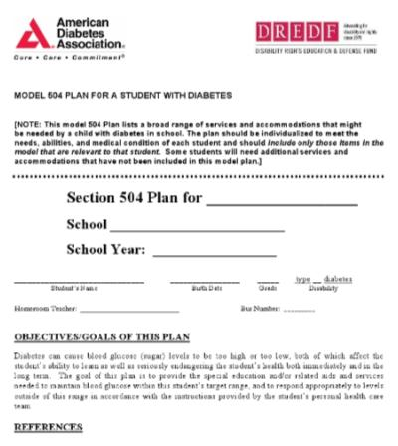
What Is a Section 504 Plan?
A written document where the parents and school agree on the services & modifications that the student needs.
Each child with diabetes has individual needs.
A Section 504 Plan must be individually developed.
Template online.

Slide 14
Considerations for Your Child’s Individualized 504 Plan
Age and maturity
Level of independence/need for assistance
Technology used (pump, CGM?)
History of past diabetes management challenges at school
Anticipated extracurricular activities
State law relevant to who may provide diabetes care in the school setting

Slide 15
Ask for the universe, but expect the world…..
Most often, the development of a 504 plan is a negotiation process
What accommodations MUST your child absolutely have?
Example: trained school staff available at all times.
What accommodations would be nice to have, but your child could live without?
Example: classroom bgm for child who needs assistance.
What are some compromises that might be made?

Slide 16
504/IEP Plan - Possible Contents
Identification of trained staff to provide care when a school nurse is not available during school day, field trips and extracurricular Immediate access to diabetes supplies and equipment
Access to snacks, water and bathroom
Classroom blood glucose monitoring

Slide 17
504/IEP Plan may also include…
Access to cell phone for diabetes management
Reasonable time/instruction to make up assignments and tests missed due to diabetes
No penalties for absences due to diabetes (illness/doctor’s appointments)

Slide 18
Key Points for Parents/Guardians
Make sure your child’s treatment plan (DMMP) is current.
Make sure an authorization for school personnel to provide care is included as appropriate.
Make sure the school has trained staff available to provide diabetes care to your child.
Be a resource for your school.
Work with the school to write a 504 Plan or IEP for your child.
Provide current contact information.
Provide supplies, equipment and food for your child.

Slide 19
The American Diabetes Association is Here to Help!
CAUTION: Keep in mind the following – especially if you are really frustrated:
Most disagreements with schools can be resolved as you educate and negotiate with school staff.
The American Diabetes Association can provide information and strategies for self-advocacy:
1-800-DIABETES
askada@diabetes.org
diabetes.org/safeatschool
1-800-DIABETES

Slide 20
Questions?

