Slide 1

CHANGES, CHALLENGES AND CHEERS
Jill Weissberg-Benchell, Ph.D., CDE

Slide 2
Diabetes is not a Do It Yourself Disease
Need a team
Need cheerleaders
Need a helping hand
Need support from loved ones
Diabetes is cared for within a family

Slide 3
DEVELOPMENTAL ISSUES FOR PRESCHOOLERS
Learning and Discovering
Magical Thinking and Creativity
Want to have Control over their world
“NO’S”
Limited Self-Awareness
Picky Eating, Unpredictable Behavior

Slide 4
DEVELOPMENTAL ISSUES FOR PRESCHOOLERS
Toddler Property Laws
1. If I like it it's mine.
2. If it's in my hand it's mine.
3. If I can take it from you it's mine.
4. If I had it a little while ago it's mine.
5. If it's mine it must never appear to be yours in anyway.
6. If I'm doing or building something all the pieces are mine.
7. If it looks like mine, it is mine.
8. If I saw it first it's mine.
9. If you are playing with something and put it down, it automatically becomes mine.
10. If it's broken it's yours.

Slide 5
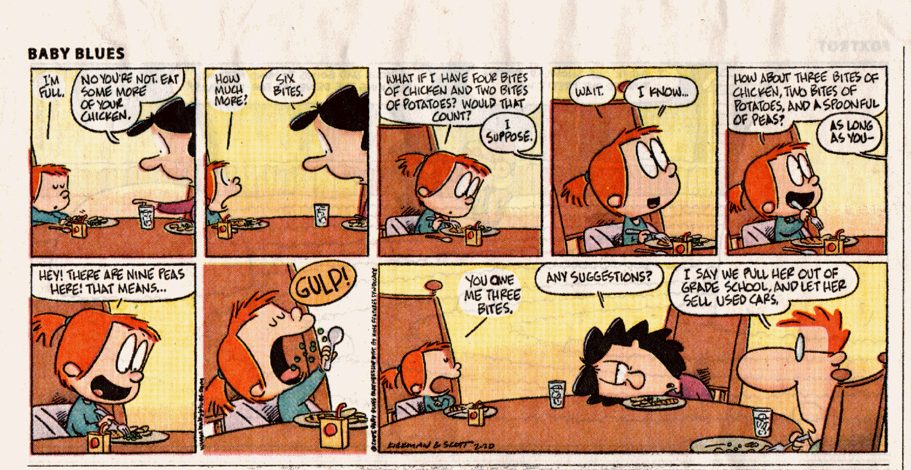
Notes:
.

Slide 6
EMOTIONAL ISSUES THAT MAY ARISE FOR PRESCHOOLERS
Emotions are not well-regulated
Communication skills are still developing.
May develop fears around blood sugar checks, insulin injections site changes.

Slide 7
PARENTS AND PRESCHOOLERS
Not allowing diabetes-specific tasks to become the primary source of attention
Offering Choices When Possible
Using Clear, Simple Language
Use Distraction During Regimen Tasks
Balancing Normative Experiences and Safety
Unique challenges of finding babysitting
IF more than one parent, share tasks

Slide 8
DEVELOPMENTAL ISSUES FOR SCHOOL-AGE CHILDREN
Time Away From Parent Supervision
Expanding “Known World”
Learning Self-Control
Recognizing Differences Among Peers
Issues of Fairness

Slide 10
EMOTIONAL ISSUES FOR SCHOOL AGE CHILDREN
Roots of Self-Esteem Begin to Grow
Pitfalls of Blame and Shame
Miscarried Helping May Begin
Peer teasing may begin

Slide 11
PARENTS AND
SCHOOL AGE CHILDREN
Separating Normative Independence Goals From The Non-Normative Task of Managing Diabetes
Providing Routines and Consistency is Critical
Important to Include Child in Family Discussions and Problem Solving.. “Think Aloud”

Slide 12
DEVELOPMENTAL ISSUES FOR EARLY ADOLESCENTS
(10-13 YEARS OF AGE)
PHYSICAL: Puberty begins. Rapid growth begins.
COGNITIVE: Tends to still be fairly concrete. Emergence of more sophisticated thinking.
EMOTIONAL: Peer teasing/Bullying. Sense of belonging
SOCIAL: Interested in forming intimate relationships with peers.
FAMILY: Increased need for privacy, push for independence/beginning to detach from parents

Slide 13
PARENTS AND PRE-TEENS
Match expectations for independence and responsibility with ability
Continue to oversee/monitor/support
Take over any time AND when needed
Encourage your child to recruit their friends for support and reminders
Collaborate to develop strategies for communications.. Texts? Emojis? Photos of meters?

Slide 14
DEVELOPMENTAL ISSUES FOR MIDDLE ADOLESCENTS
(14-17 YEARS OF AGE)
PHYSICAL: Puberty is ending. Girls are ending their growth spurt. Boys may be just starting.
COGNITIVE: Emergence of more sophisticated thinking.
EMOTIONAL: Identity development. Thinking about leaving home.
SOCIAL: Peers, sexuality, dating.
FAMILY: Interdependence?

Slide 15

ZITS © ZITS Partnership, King Features Syndicate.
Notes:
15

Slide 16
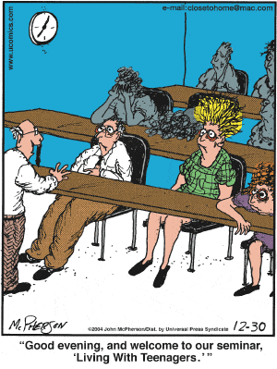

Slide 17
DEVELOPMENTAL ISSUES FOR ADOLESCENTS
Wanting to be the same as peers
Increased problem-solving and abstract thinking skills
Ability to understand goals of treatment regimen
Frustration that adherence doesn’t always lead to improved outcomes, and poor adherence doesn’t always lead to worse outcomes.
Desire for increased independence and responsibility

Slide 18
DEVELOPMENTAL ISSUES FOR ADOLESCENTS
Increasing independence often results in decreasing supervision.
Schedules are more erratic than younger peers.
Puberty may play a role in diabetes outcomes.
Experimenting in Sex, Drugs, Alcohol.
Sense of invulnerability in this age group.

Slide 19
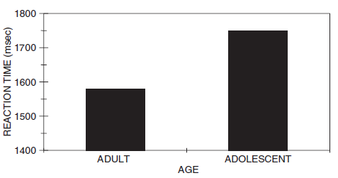
DEVELOPMENTAL ISSUES FOR ADOLESCENTS
Sense of invulnerability in this age group.
Is it wise to…
  Swim with sharks?
  Drink Drano?
  Set your hair on fire?

Slide 20
DEVELOPMENTAL ISSUES FOR ADOLESCENTS
Understand Sarcasm.
Understand – keenly aware of – Hypocrisy
Sometimes will not pay attention to the risks or consequences of what they do

Slide 21
THE DEVELOPING BRAIN
fMRI data shows huge changes as individuals move from childhood through adulthood.
Prefrontal Cortex:
  Planning ahead
  Controlling impulses
  Decision making
  Goal setting
  Metacognition
  Emotion regulation
  Evaluating risks and rewards

Slide 22
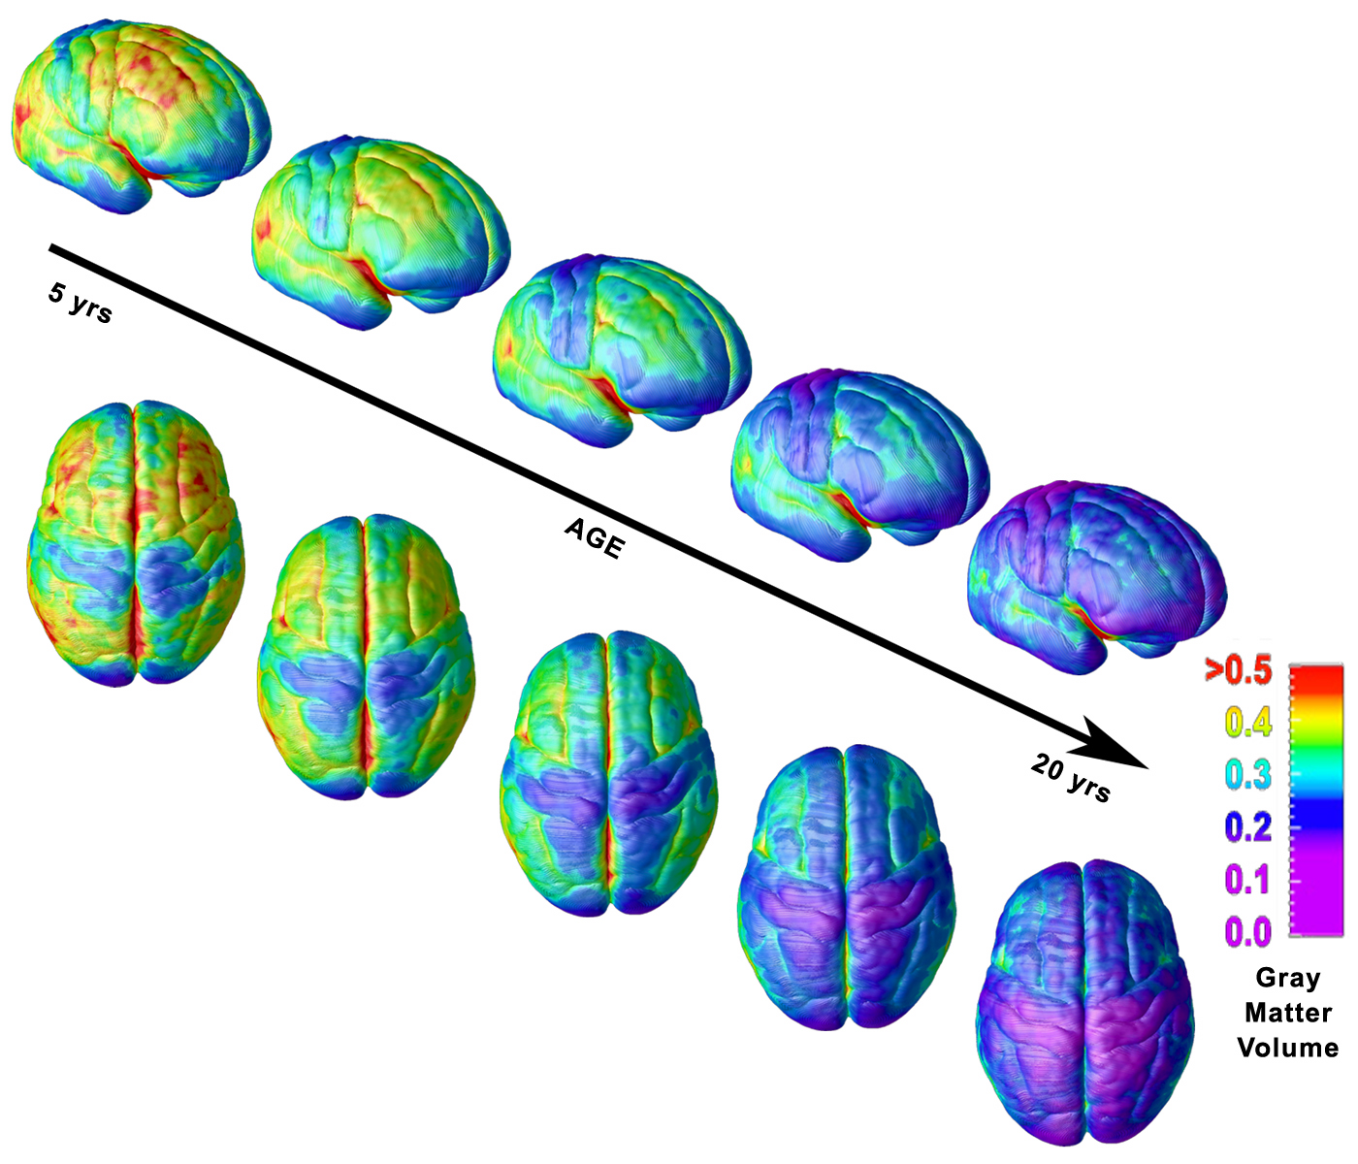
Time-Lapse Imaging
Tracks Brain Maturation
from ages 5 to 20
10-year NIH fMRI study
4-21 y.o. participants
Brain continues to
Change until mid 20s

Slide 23
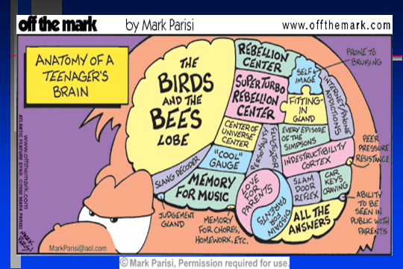

Slide 24
EMOTIONAL ISSUES FOR TEENAGERS
Pubertal changes
Managing moods
Increased risk for emotional distress and/or depression
Miscarried helping may lead to increased conflict

Slide 25


Slide 26






The vicious cycle of miscarried helping
Parents’ worries,
concerns, fears
Parents and adolescent
become frustrated, discouraged, angry
Adolescent feels accused, criticized, blamed, incompetent
Decreased motivation, decreased desire for collaboration, decreased desire for honest discussions about challenges/frustrations
Anderson BJ, et al. Diabetes Care. 1999;22:713-721.
Notes:
One of the things that often happens is what Barbara Anderson talks about as the vicious cycle of miscarried helping. This cycle occurs when the parents have lots of worries, concerns, or fears about their children’s well-being, health, and safety.
Sometimes parents cannot communicate those worries, concerns, and fears in a way that their teens hear as genuine worries, concerns, or fear. Instead, the message is received by the teen as accusing, criticizing, and blaming. Also, the message is that the adolescent is incompetent.
When the adolescent hears the worry or fear as an accusation or a criticism, then sometimes they have less motivation. They have a decreased desire for collaboration and an honest discussion about the challenges and frustrations inherent in diabetes, because they are convinced that what is going to happen is that they are going to be told, again, that they are incompetent, and it’s their fault. If you are hearing that as the message, then you’re not very likely to want to collaborate and discuss the challenges of life with diabetes.
This then leads the parents and adolescents to become very frustrated with each other, very discouraged with each other, and with diabetes. After that, the teens tend to be less open, less honest, and less direct, which increases parents worries, concerns, and fears. So, the vicious cycle continues.

Slide 27
PARENTS AND TEENAGERS
Diabetes is a family disease
Avoiding a blame/shame cycle
Balancing nagging with monitoring
Matching self-care responsibility with level of skill
Promoting family discussions and family problem-solving
Does your tone of voice change when talking about diabetes?

Slide 28
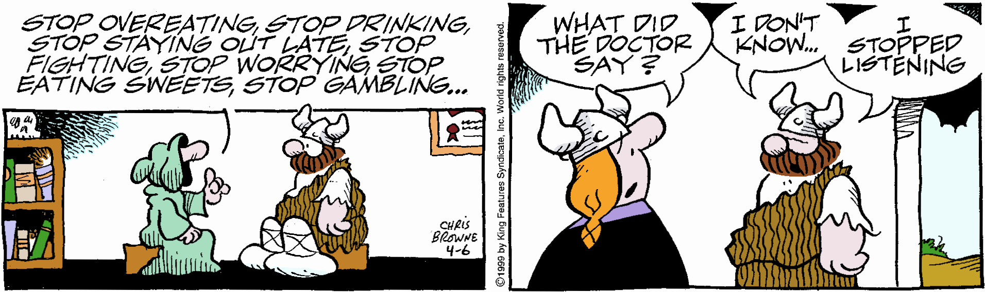
Why Nagging Does Not Work

Slide 29
PARENTS AND TEENAGERS
Separating normal responsibilities from diabetes-specific responsibilities
Encouraging success in normal tasks
Normalize burn out and plan for it
Clarifying who is responsible for:
  Monitoring supplies, Watching the clock
  Carbohydrate counting, Insulin administration
  Blood sugar checking, other tasks

Slide 30


Slide 31
Interdependence is Key
No one is truly independent.
Isolation leads to poor psychosocial and medical outcomes
Support, Collaboration and Teamwork is the Magic Sauce
Minimize Judgment and Shame

Slide 32
Interdependence is Key
The hallmark of being an adult is knowing when you need help, and asking for it.
Normalize feelings of “burn-out” and plan for them. This is not a failure.
  Schedule times when responsibility is turned back to parents and then back to teen.

Slide 33
SURVIVAL ADVICE
Sharing Responsibility
  Avoid Excessive Self-Care Autonomy
  Facilitate Interdependence
  Separate Knowledge from Judgment and Maturity
  Avoid Vicious Cycle of Miscarried Helping

Slide 34
CONSIDER, DISCUSS, PROBLEM-SOLVE
How do you communicate as a family?
How do you problem-solve as a family?
How do you resolve disagreements as a family?
How do these things change as your child grows and develops?
How do you balance their development and push for independence with supervision and supportive monitoring?

Slide 35
LEARN To LISTEN
Limit distractions. Silence technology
Pay attention to what is being said, not what you want to say. Repeat the last sentence the other person says. This keeps your attention on each statement.
Be OK with silence. You don’t have to always reply or have a comment.
Encourage your child to offer ideas and solutions before you give yours. Listen 80 percent of the time, talk 20 percent.
Restate the key points you heard and ask whether they are accurate. “Let me see whether I heard you correctly…” is an easy way to clarify any confusion.
Being a strong, attentive listener will help you be a better parent.

Slide 36

FINDING THE POSITIVE
Family teamwork
Healthy behaviors for the whole family
Family routines and organization
Diabetes Community Friendships and Support
What is going well with diabetes management in your family?
What are some of the positive experiences your family has had?

Slide 37
ENCOURAGING POSITIVE BEHAVIORS
Listening works better than nagging
Find a communication system that works for your family
Ask about something other than diabetes first
Praise, not punishment
Catch your child doing diabetes management well
Celebrate every diabetes success!
Problem-solve together
Avoid commands, unsolicited advice
Be open-minded about everyone’s ideas and input
Reinforce behaviors, not numbers
Focus on management behaviors
BG & A1c are data, not good or bad or like grades
Praise the behaviors you want to see more of

Slide 38
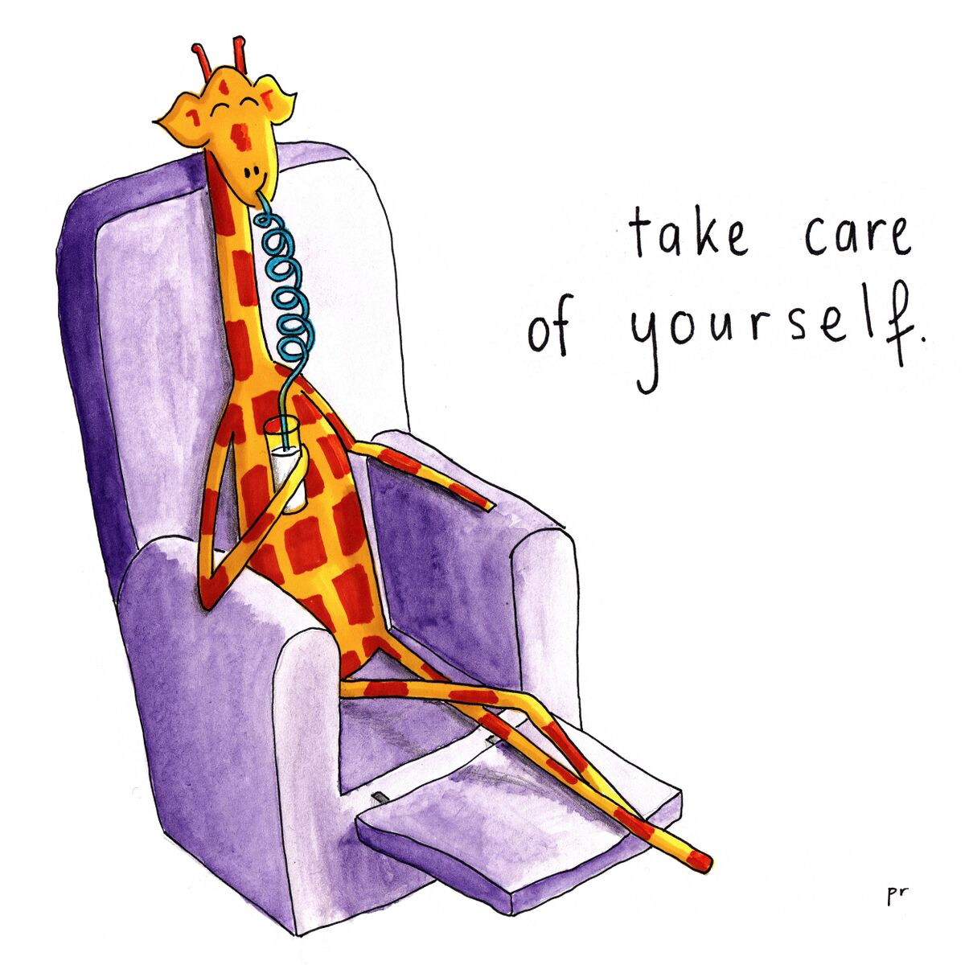
Self-care is not Selfish
Ask for help with something specific
  Who can you ask for a hand?
  What is one thing they can do to help?
Set time aside for your own needs so that you are refreshed to take care of your family
  What energizes you? What relaxes you?
  When can you fit it into your schedule?
  Who can help you make a little time for yourself?
MotivatingGiraffe.com

Slide 39

A little laughter goes a long way.
Diabetes is serious business.
Also, funny stuff happens.
Finding humor in stressful situations can be a useful (and fun) way to get through it.
Great model for your children for managing diabetes challenges.

Slide 40
