Slide 1
Dr Fiona M Campbell
Consultant in Paediatric Diabetes, Leeds Children’s Hospital
National Clinical Lead, Children & Young People’s Diabetes Network
PICU Study Day @ LCH
24th October 2017

Slide 2
Sick days & Stressful Days

Slide 3
Content
Introduction to diabetes
Sick Day Rules
Diabetic ketoacidosis (DKA)
Complication of DKA
Hypoglycaemia
Undergoing surgery
Summary

Slide 4
Ancient History
Ebers papyrus
c.1550 BC
Sushrut & Charak
400-500 BC
Sweetness of urine
Overweight & gluttonous
Also lean people
Notes:
The hindu physicians Sushrut and Charak who wrote between 4-500BC were probably first to discover the sweetness of diabetic urine.
Either by tasting or noting that ants congregated around it.
Noted it was most prevelant in the overweight and gluttonous, who indulged in sweet & fatty foods and physical exercise & vegetables were the mainstay of treatment.
Also recognised that it affected lean people in whom it was more serious.

Slide 5
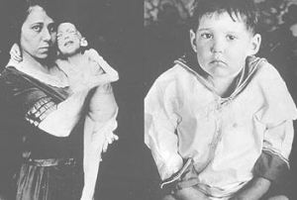
20th Century
Banting & Best, Macleod, Collip
1921
Chilled extract – ‘isletin’
January 1922
Treated 14 year old boy
Normalised glucose levels
Notes:
Leonard Thompson was treated in January 1922 with beef pancreas extract.
The first injection prepared by banting caused a sterile abcess.
Collip refined the extraction and the 2nd injection was more succesful
Leonard Thompson lived a further 13 years and died of pneumonia.
Insulin revolutionised the treatment of diabetes, and it saved the lives of many who would otherwise have died, but its unforseen effect was to transform an acute, rapidly fatal illness into a chronic disease with serious long term complications.

Slide 6
Islets of Langerhans
4 main cell types in islets
α,β,δ and Pancreatic Polypeptide cells
Normal pancreas has 1 million islets-only 2-3% of the gland’s mass
Notes:
Paul Langerhans was the 1st to describe small clusters of cells with distinct morphology in preparations of the pancreas(haemotoxylin and Eosin stain)
The cells were named ’islets of langerhans’ post humously.
Normal pancreas has 1million islets, only 2-3% of the gland’s mass
The 4 main cell types a,b,d and pancreatic polypeptide.
Beta cells are most numerous – insulin producing cells

Slide 7
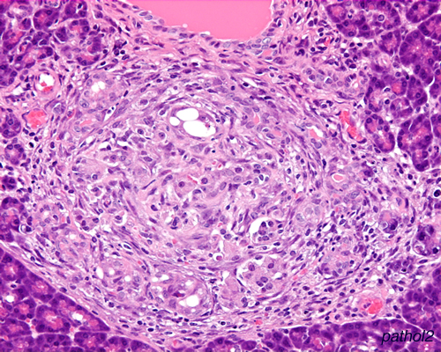
Islets of Langerhans
Chronic inflammatory infiltrate
Later complete B cell loss
Islet related antibodies
Eg. IA2 and GAD
Notes:
Paul Langerhans was the 1st to describe small clusters of cells with distinct morphology in preparations of the pancreas
The cells were named ’islets of langerhans’ post humously.
Normal pancreas has 1million islets, only 2-3% of the gland’s mass – volume together no larger than a finger tip (Contains total 200 units of insulin in an adult)
The 4 main cell types a,b,d and pancreatic polypeptide.
Beta cells are most numerous – insulin producing cells
In type 1 diabetes – the most common in children and adolescence - there is autoimmune mediated destruction of the B cells – islets with chronic inflammatory infiltrate - with mainly t-cells and macrophages.

Slide 8
Evolution of Type 1
Notes:
One model of evolution is that individuals have a genetic predisposition to the disease.
Enviromental factors then act as triggers of the T-Cell mediatd autoimmune destruction of B cells – insulinitis and decreased B cells
Glucose intolerance first with loss of 1st phase of insulin secretion
Subsequently clinical onset of overt diabetes
Still B cells present therefore C-peptide detectable and honeymoon phase.
Immune modulation tried before frank diabetes occurs.

Slide 9
Normal physiology

Slide 10
Insulin Regimens

Slide 11
Introduction
Notes:
28,439 in UK in lasr RCPCH survey 2015-16
Projected increase 70% from 2005-2020 (Lancet)
95.3% Type 1 Diabetes
1.9% Type 2

Slide 12
Sick Day Rules
Illness with diabetes can precipitate:
↑Glucose, ↓Glucose
+/- Ketosis/acidosis
Increase in counter-regulatory hormones
Increase in gluconeogenesis Glucose
Increase in ketone production Acids
Notes:
Counter regulatory hormones – Increase in gluconeogenesis and ketone production

Slide 13
Causes for Ketosis
Swedish National Study
142 episodes of DKA
30/115 used pumps
Causes for DKA
Missed insulin doses 48.6%
Gastroenteritis 14.1%
Infection 13.4%
Pump problem 12.7%
Social problem 1.4%
Unknown 5.6%
Notes:
Gastroenteritis is not a very common cause
Beware of vomiting in patients with diabetes
Can be illness but also ketosis/DKA due to insulin deficiency, it can be gastroenteritits but exclude ketosis first.
Most episodes of DKA with pump in the 1st year so likely due to inexperience with the pump. There was no evidence of increased DKA in established pump patients.

Slide 14
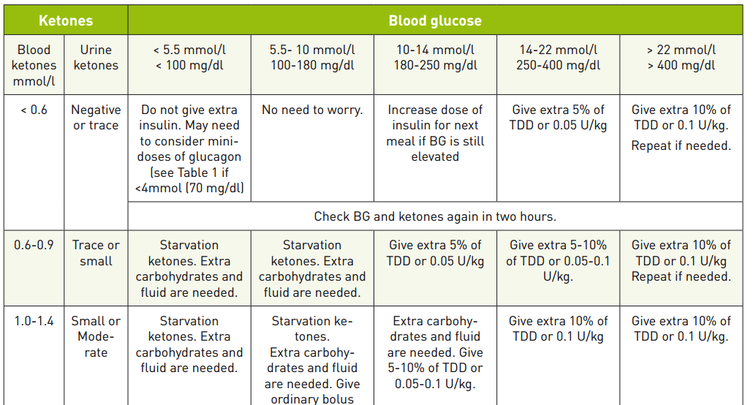
Sick Day Rules

Slide 15
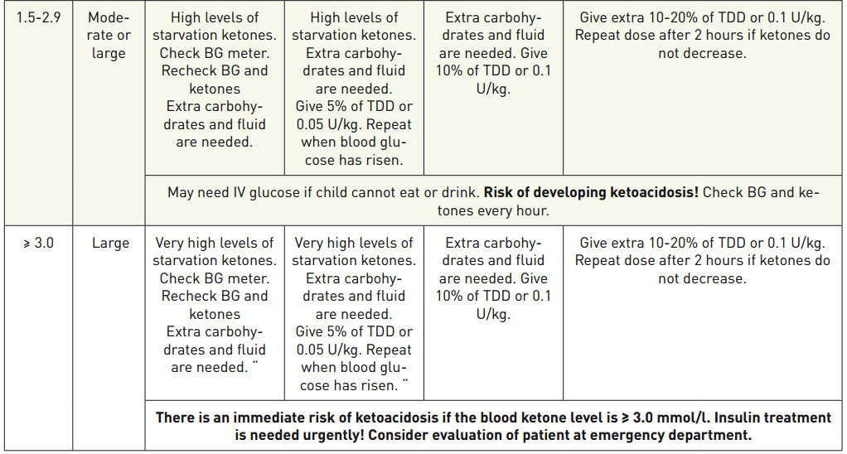
Sick Day Rules

Slide 16
Notes:
Study showed importance of keeping hydrated.
With pump stop – with hydration only blood glucose rarely over 20 with even with no insulin
Ketones rise but no DKA in4-6 hours therefore time to react.
However more ketosis with illness.

Slide 17
Sick Day Rules
During sick days – do not stop insulin
Insulin dose may need to be increased or decreased temporarily
Vomiting – Consider to be due to insulin deficiency unless proven otherwise
Home glucose & ketone monitoring should always be available.
Notes:
ISPAD/IDF guidelines

Slide 18
Diabetic Keto Acidosis (DKA)
Mortality
DKA commonest cause of death in children with diabetes
Notes:
Mortality in the UK 2009 study from diabetic ketoacidosis is low at approximately 2%

Slide 19
DKA
DKA is more common in children under 5
40% present in DKA,
20% severe DKA
16% in those >14 yrs
Omission of insulin - leading cause for recurrent DKA in adolescents.
5% of patients account for >25% of all DKA admissions
Notes:
Cerebral and other autoregulatory mechanismsnot as well developed in younger children and more difficult to get classical history of polydipsia/polyuria/weight loss.
Adolescents - 5% of patients account for >25% of all admisssions for DKA

Slide 20
Classification of Severity
Children and young people with a pH of 7.1 or above have MILD or MODERATE DKA
Children and young people with a pH of less then 7.1 have SEVERE DKA

Slide 21
Physiology
Glucose ⬇ | Glucose ⬆
Insulin

Slide 22
Physiology
Glucose ⬇ | Glucose ⬆
Insulin | Glucagon
 | Catecholamines
 | Cortisol
 | Growth Hormone
Notes:
Counterregulatory hormones
Gluconeogenesis, Glycogenolysis and hepatic glucose output
Peripheral glucose uptake

Slide 23
Physiology
Insulin
Fat
Muscle
Insulin
Glycogen
Glucose
Brain
Notes:
Hydrophobic

Slide 24
Physiology
Ketones
H+
Insulin
Fat
Muscle
Glucagon
Glycogen
Glucose
Insulin
Brain
Renal overflow
Notes:
Other hormones :Cortisol, GH, Glucagon, Catecholamines, Thyroxine
Due to stress, infection & exacerbated by insufficient insulin or intake
Net result: hyperglycaemia, osmotic diuresis, acidosis - ketones & lactic acidosis

Slide 25
Presentation of DKA
Polyuria, Polydipsia, Weight loss
Nausea and vomiting
Abdominal pain
Dehydration
Tachypnoea/Kussmaul respiration
Altered conciousness

Slide 26
Presentation of DKA
Hyperglycaemia (>11mmol/l)
Acidosis (pH <7.3, HCO3<18)
Ketotic (Usually >3mmol/l)
Notes:
and who are
• more than 3% dehydrated
• and/or vomiting
• and/or drowsy
• and/or clinically acidotic

Slide 27
DKA Management
Guidelines
Insulin treatment
Not necessary in 1st hour/may be dangerous
No place for large doses/boluses in 1st 2 hours
Fluid management
Large volumes of fluid must be avoided
Correctdehydration over 48 hours
Use of 0.9% Saline for whole duration of dehydration
Use fluid with added Potassium
Fluid bolus only if shocked – not if mild/moderate
Notes:
Boluses no more than 30mls/kg and no more than 8% dehydrated
We overestimate dehydration

Slide 28
Fluids
Deficit
Assume a 5% fluid deficit in children and young people in mild or moderate DKA (indicated by a blood pH of 7.1 or above)
Assume a 10% fluid deficit in children and young people in severe DKA (indicated by a blood pH below 7.1)
Maintenance
if they weigh less than 10 kg, give 2 ml/kg/hour
if they weigh between 10 and 40 kg, give 1 ml/kg/hour
if they weigh more than 40 kg, give a fixed volume of 40 ml/hour.
Resuscitation fluid
If more than 20 ml/kg 0.9% sodium chloride has been given by intravenous bolus, subtract any additional bolus volumes from the total fluid calculation for the 48-hour period
Notes:
Deficit –
It is not possible to accurately clinically assess the degree of dehydration to work out the deficit.
Maintenance
These are lower than standard fluid maintenance volumes because large fluid volumes are associated with an increased risk of cerebral oedema. Do not use other methods of calculating maintenance fluids, for example APLS, as these over-estimate fluid requirement.

Slide 29
DKA Management
Guidelines
Insulin
Required to switch off ketone production that is causing acid build up
If blood glucose is low - then add dextrose
DO NOT STOP INSULIN
Monitor ketones

Slide 30
Physiology
Ketones
H+
Insulin
Fat
Muscle
Glucagon
Glycogen
Glucose
Insulin
Brain
Renal overflow
Notes:
Other hormones :Cortisol, GH, Adrenaline
Due to stress, infection & exacerbated by insufficient insulin or intake
Net result: hyperglycaemia, osmotic diuresis, acidosis - ketones & lactic acidosis

Slide 31
Medical Monitoring
Regular review - 1,2,4 hrs – Blood sampling for pH /Plasma Glucose/ Electrolyes
At each face-to-face review assess the following:
results of blood investigations
ECG trace
cumulative fluid balance record
clinical status, including vital signs and neurological status looking for complications

Slide 32
Cerebral Oedema
Cerebral Oedema
60-90% of deaths in DKA
Once develops 20-25% result in death
10-25% survivors - significant morbidity
Aspiration Pneumonia
Pulmonary Oedema/Acute Respiratory Distress
Electrolyte disturbance
Acidosis
Other neurological pathologies/poor brain perfusion
Notes:
Aspiration Pneumonia - NG tube
Neurological pathologies - cerebral venous thrombosis/sub-arachnoid haemorrhage/acute obstructive hydrocephalus

Slide 33
Cerebral Oedema
Risk Factors
Newly Diagnosed Diabetes
Young Age
Severe Acidosis
High Plasma urea
Low pCO2
High Potassium
Insulin treatment within 1st hour of fluids
Large volumes of fluid
Lower plasma Sodium
Notes:
Because Cerebral Oedema is the leading cause of death in DKA - looked into further
3 Case control studies
Highest risk are those that are young/newly diagnosed/severely acidotic - close monitoring

Slide 34
Cerebral Oedema
Features:
Usually period of improvement in clinical condition then
Headache
Behaviour changes
Neurological deterioration
Sudden respiratory arrest
Notes:
Study in UK
10/44 cases had headache-
2 at same time as deterioration
2 after
6 at 2-12hrs before event/and in 2 2-3 hrs before respiratory arrest
2/30 controls
Headache before admission and not mentioned again during treatment

Slide 35
New DKA Guidelines
The following changes have been made since the last version (2009):
1. Change in the degree of dehydration to be used to calculate fluids; 5% for mild to moderate DKA and 10% for severe DKA, based on pH
2. De-emphasise sodium chloride bolus at the start of treatment apart from the sickest children
3. No more than one 10ml/kg fluid bolus to be given without discussion with a senior doctor
4. Further reduction in maintenance fluid rates, and simpler calculation of fluid rates
5. No longer to subtract any boluses given up to 20 ml/kg from the fluid calculation (as the rate is already reduced significantly from previous guidelines)
6. Continuation of 0.9% sodium chloride (instead of changing to 0.45% sodium chloride) for the full duration of rehydration
7. Option for using an intravenous insulin infusion rate of 0.05 Units//kg/hour OR 0.1 Units/kg/hour

Slide 36
New DKA Guidelines
These are general guidelines for management. Treatment may need modification to suit the individual patient and these guidelines do not remove the need for frequent detailed reassessments of the individual child's requirements.

Slide 37
Hypoglycaemia
Blood glucose ≤ 3.9mmol/l
Mild/moderate hypos – more common
Severe hypos – loose consciousness, seizures, death
Notes:
DCCT (Diabetes complications and control trial) showed as treatment intesified so did the incidence of hypos.
Hypo unawarness occurs with frequent hypos and can be reversed by avoiding hypoglycaemia for 2-3 weeks.
Mode of measurement
10-15% lower with meters
Meters are accurate within 15% of blood sugar reading
Haematocrit
Venous or arterial (arterial 10% higher)
Hypoglycaemia can affect cognitive function and is a significant factor in excess mortality in diabetes patients.
Sudden nocturnal deaths in young persons with type 1 has been described as ‘dead in bed’ syndrome and is responsible for about 6% of those under 40 years. Nocturnal hypoglycaemia has been implicated as the cause for these deaths.

Slide 38
Hypoglycaemia
Mismatch between insulin, food and activity
Rarely spontaneous
Exercise
Stress
Hot weather
Alcohol

Slide 39
Symptoms
Neuroglycopenic
Difficulty concentrating
Blurred vision
Altered judgement/confusion
Loss of consciousness
Autonomic
Trembling/Tachycardia
Cold Sweatiness, headache & nausea

Slide 40
Treatment
Mild/Moderate hypos:
5g of glucose is needed for a 10kg child
10g of glucose is needed for a 30kg child
15g of glucose is needed for a 50kg child
Severe:
IM Glucagon/Call for help
Notes:
Approximately 0.3g/kg
Recheck blood glucose in 15 minutes >5.6 or normoglycaemia

Slide 41
Treatment
Notes:
Chocolate is not recommended as it takes longer to absorb the carbohydrate

Slide 42
Notes:
Change in carbohydrate content

Slide 43
Hypo Poster
Notes:
Education and use of CGM with temporary suspend for treatment of severe recurrent hypos especially night time.

Slide 44
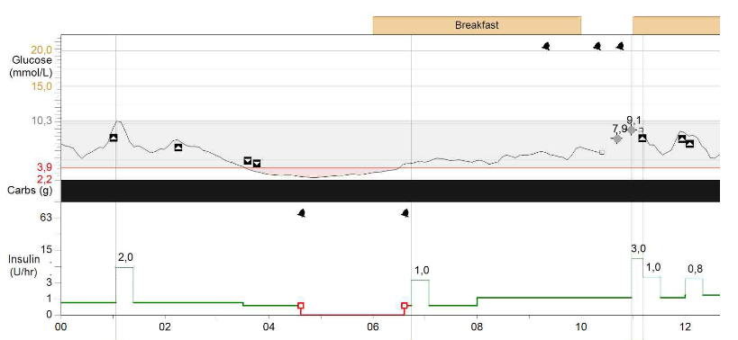
Low glucose suspend
Notes:
Education and use of CGM with temporary suspend for treatment of severe recurrent hypos especially night time.
Exclusion of Adrenal antibodies/Coeliac screen/hypothyroidism and in rare cases insulin antibodies.

Slide 45
Predictive low glucose suspend

Slide 46
Pre operative assessment
Minor
Elective
Major
Emergency

Slide 47
Pre operative assesment
Minor surgery: short procedure (usually less than 30 minutes) with or without sedation or anaesthesia where rapid recovery is anticipated and the child is expected to be able to eat by the next meal. Examples include endoscopic biopsies, myringotomy, incision and drainage.
Major surgery: includes all surgery requiring more prolonged general anaesthesia lasting >30 minutes or a procedure which is likely to cause post-operative nausea, vomiting or inability to feed adequately.

Slide 48
Pre-operative assessment
Role of surgeon carrying out surgery/procedure
As soon as the decision is made to undertake surgery, the surgeon needs to inform both the hospital paediatric diabetes team and the anaesthetist about:
Date and time of planned procedure (if possible, please put child first on the morning list)
Type of procedure and whether it is judged to be major or minor surgery as defined above

Slide 49
Emergency Surgery
Weigh the patient, measure capillary and plasma blood glucose, venous blood gases, blood ketones, electrolytes, urea and creatinine.
Inform diabetes team on admission
If ketoacidotic
Follow guidelines on Diabetes Ketoacidosis
Operate when rehydrated, blood pressure is stable, blood gas is normal, sodium and potassium in normal range
This may not be possible for some life saving operations
If not ketoacidotic
Follow guideline on major elective surgery and start fluid maintenance and intravenous insulin as discussed later
For those on insulin pumps, the pump should be stopped once the IV infusion is started

Slide 50
Summary
Introduction to diabetes
Sick Day rules
Managing DKA
Complication of DKA – Cerebral oedema
Hypoglycaemia
Preparing for surgery
Notes:
Should be familiar with safely managing DKA, reducing risk of developing cerebral oedema and how to treat this.
Giving advice over the phone following sick day rules
Safely manage hypoglycaemia and recognise possible causes/presentation

